Slide 1
Conservation Tools for Private Land
Conserving Land and Protecting Water
Wednesday, May 2, 2018
Hilton Garden Inn, Bozeman, MT
Christian Dietrich
General Counsel
The Montana Land Reliance

Slide 7
Conservation Easements and Montana Law
Section 76-6-104(2), MCA:
"Conservation easement" means an easement or restriction, running with the land and assignable, whereby an owner of land voluntarily relinquishes to the holder of such easement or restriction any or all rights to construct improvements upon the land or to substantially alter the natural character of the land or to permit the construction of improvements upon the land or the substantial alteration of the natural character of the land, except as this right is expressly reserved in the instruments evidencing the easement or restriction.

Slide 8
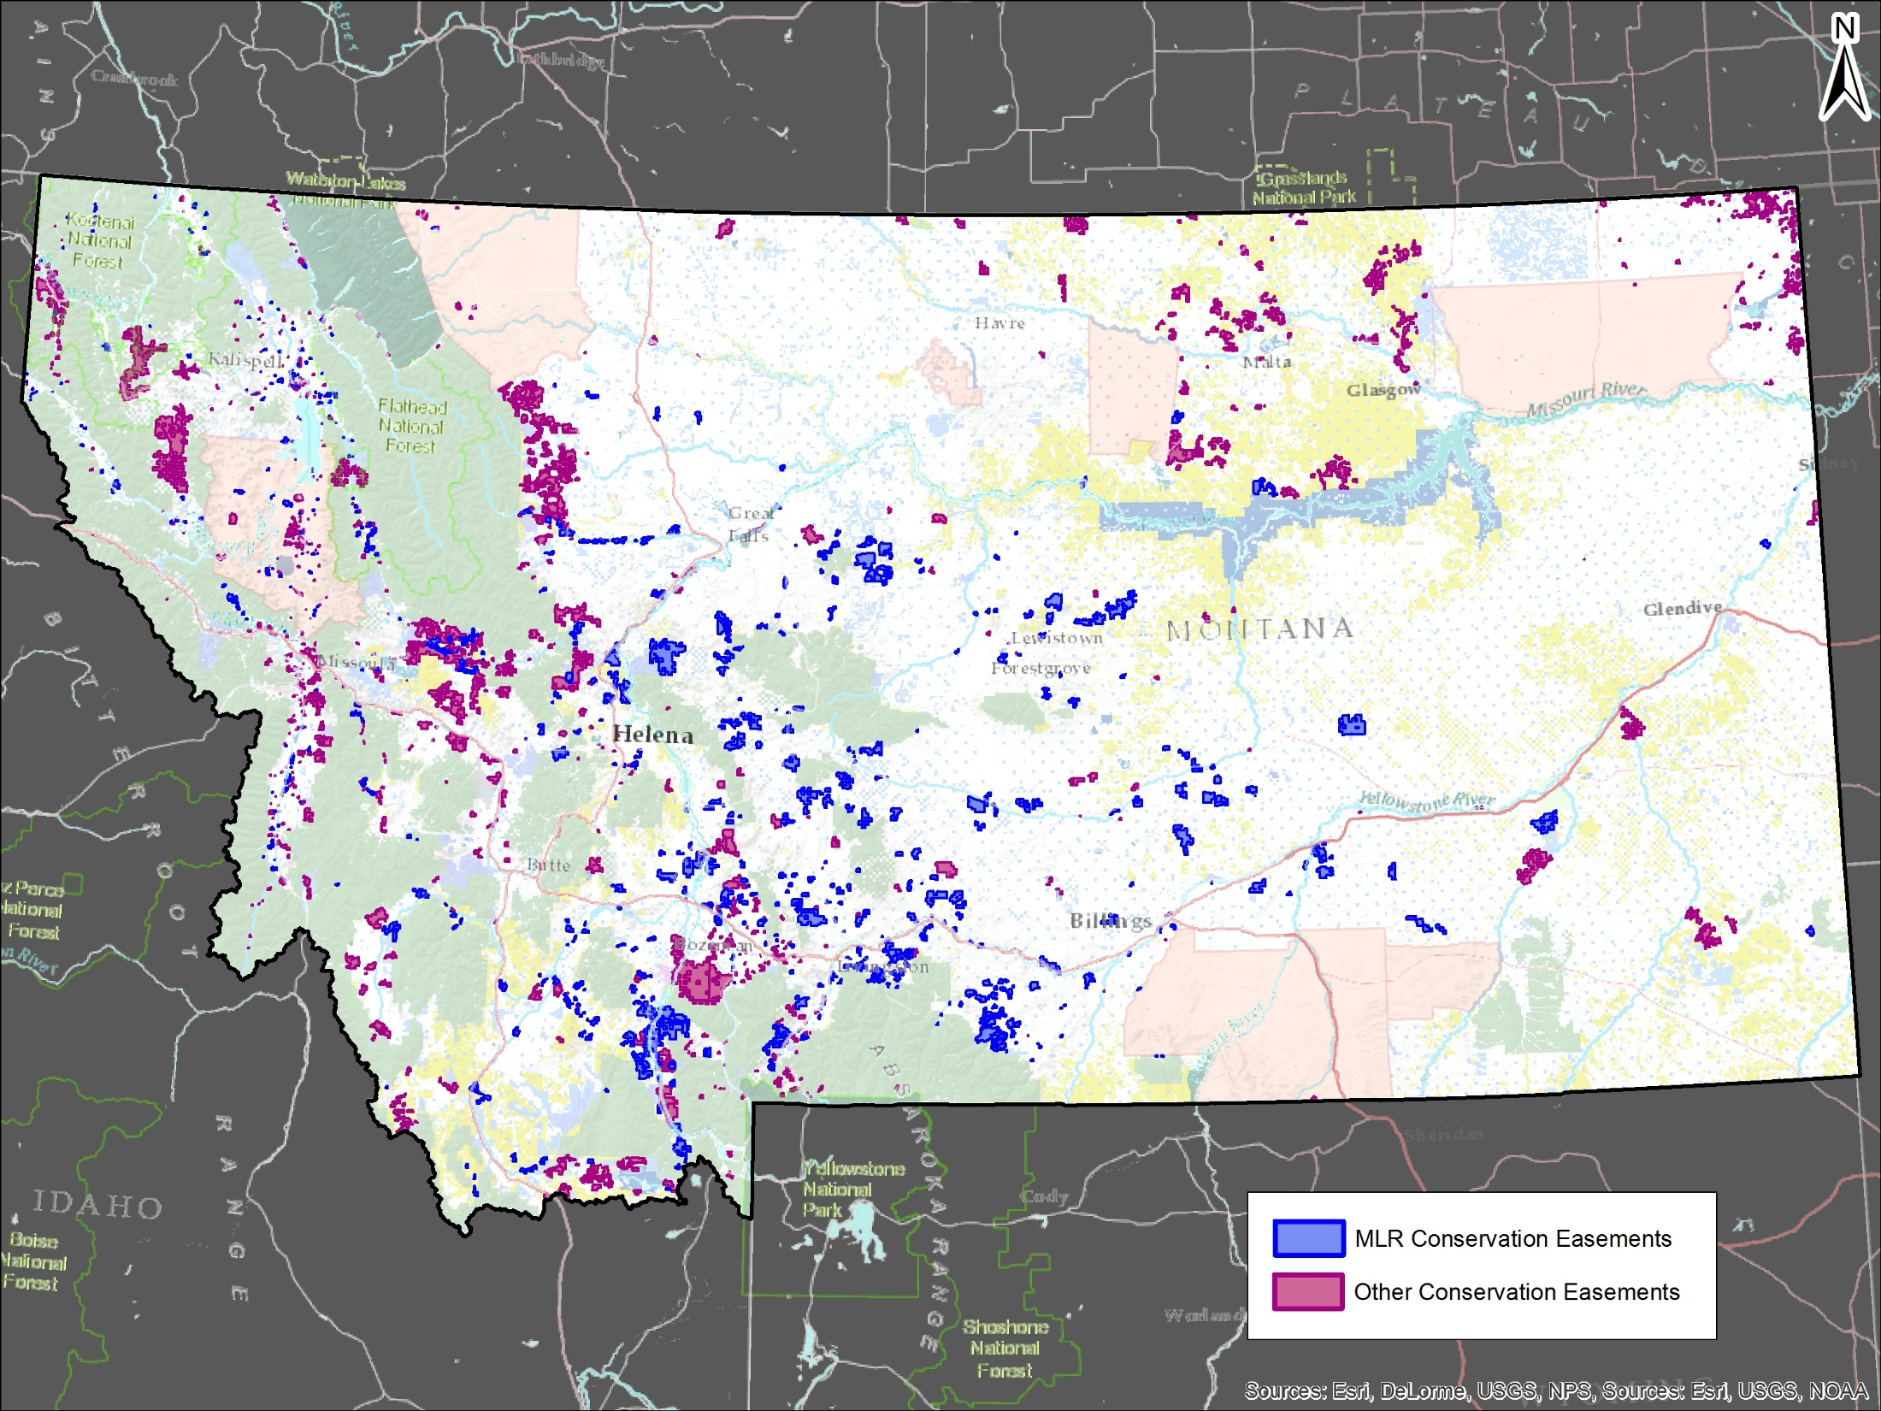

Slide 9
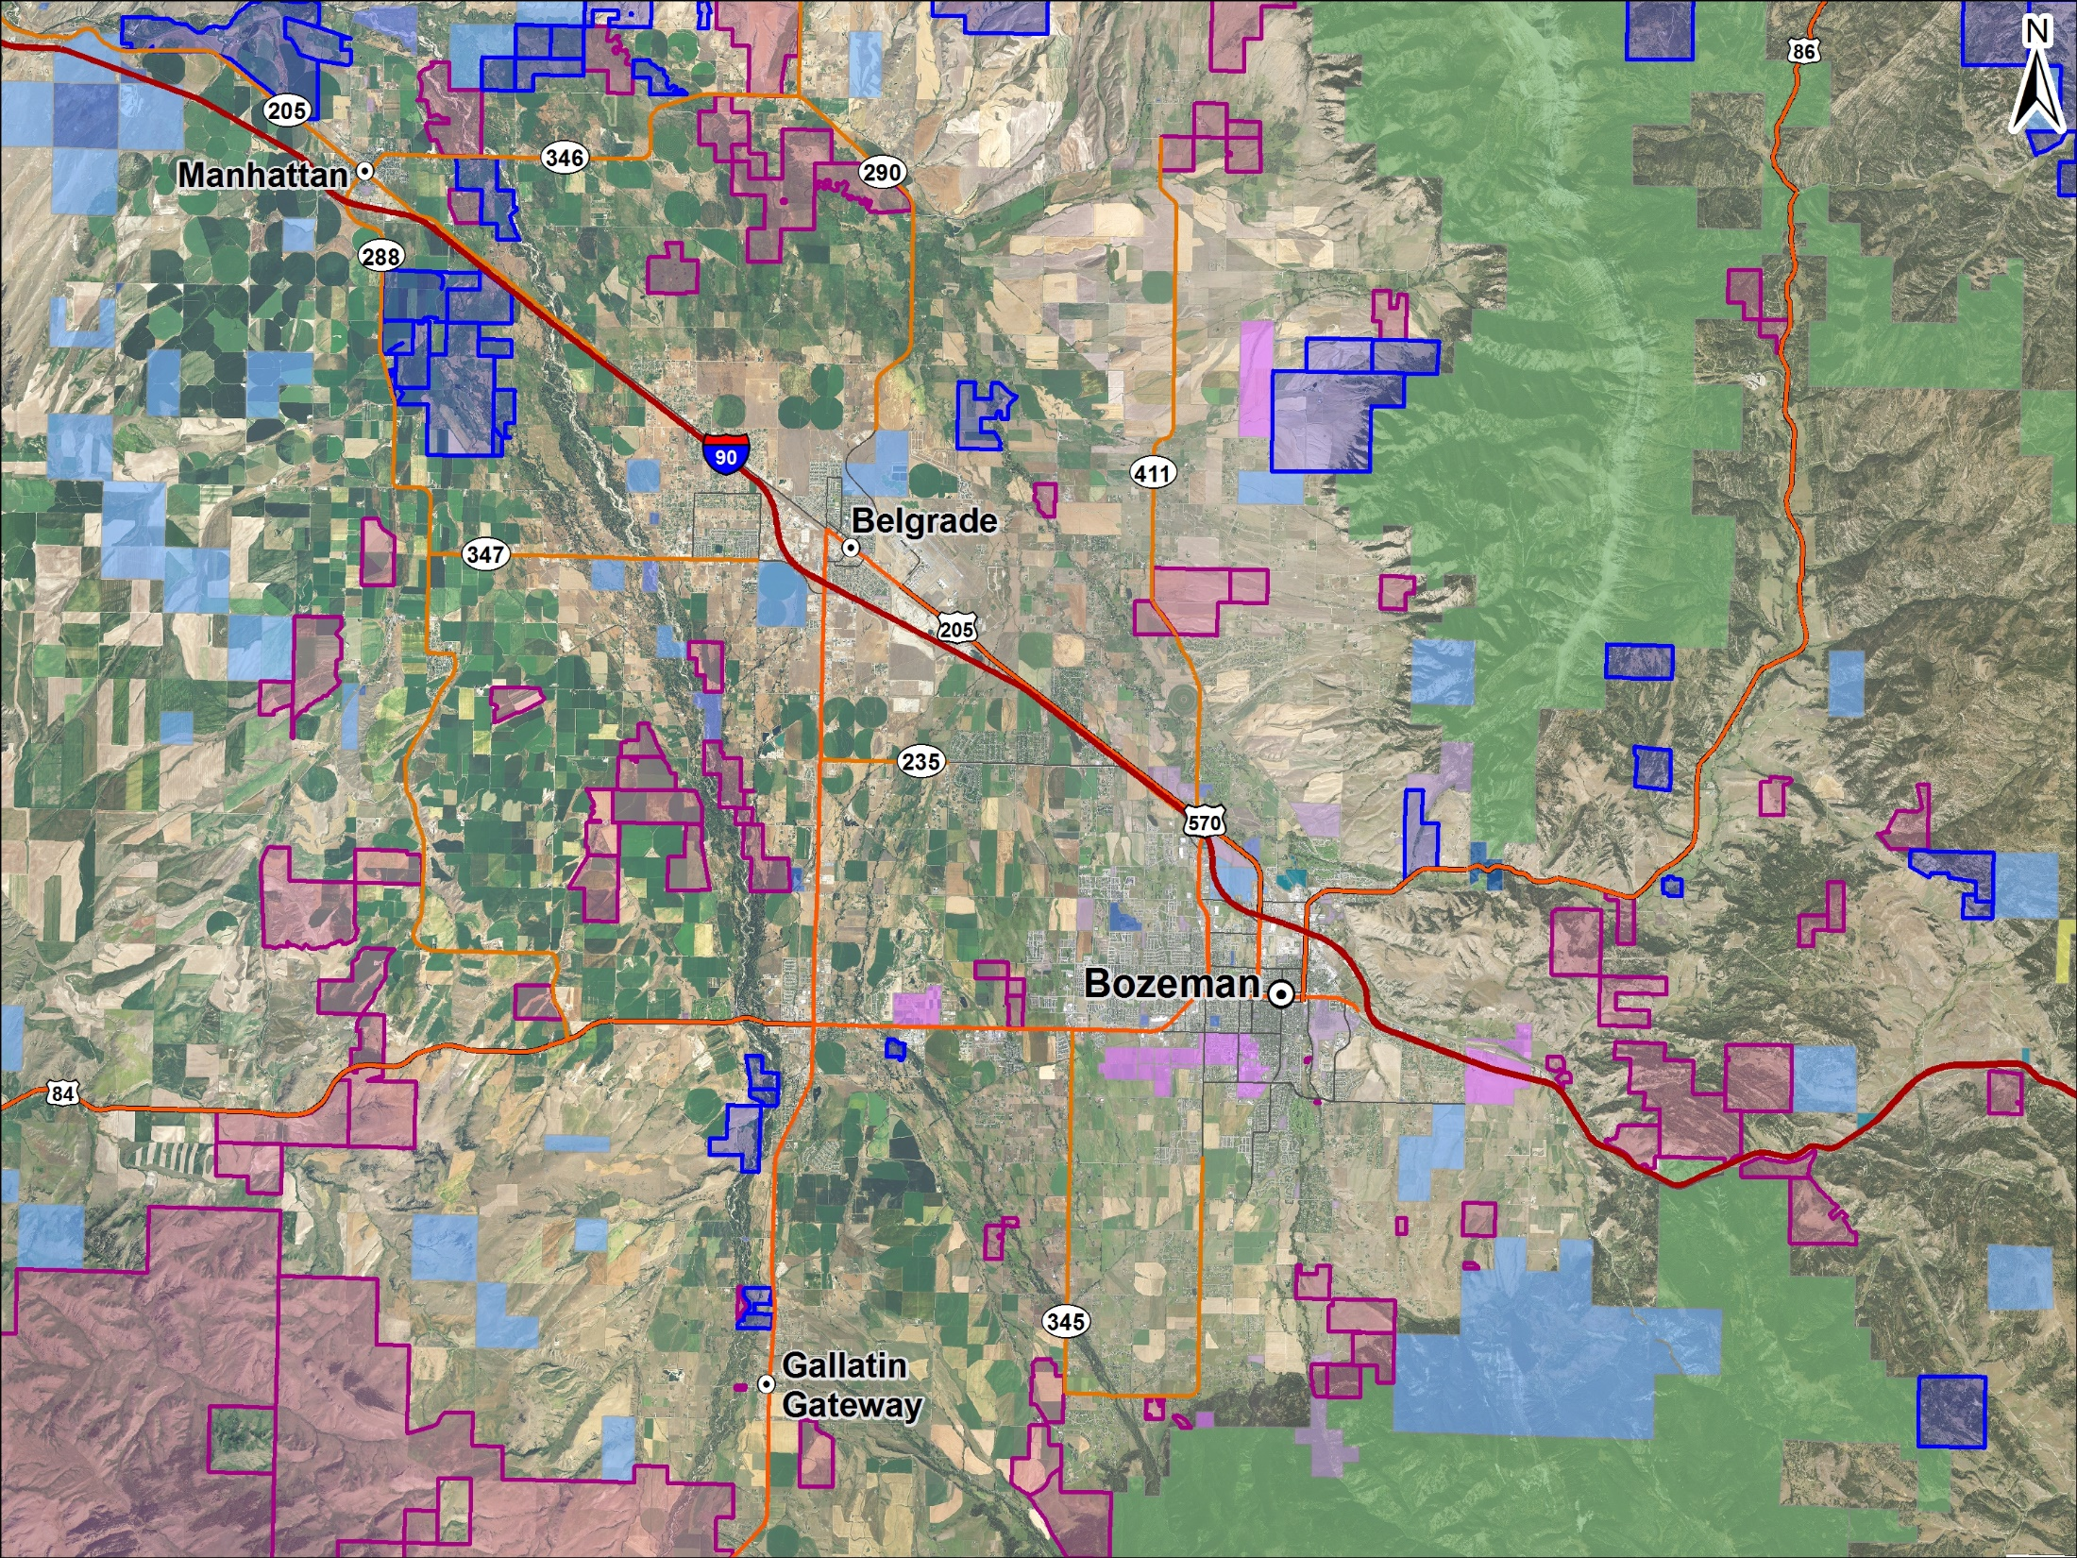

Slide 10
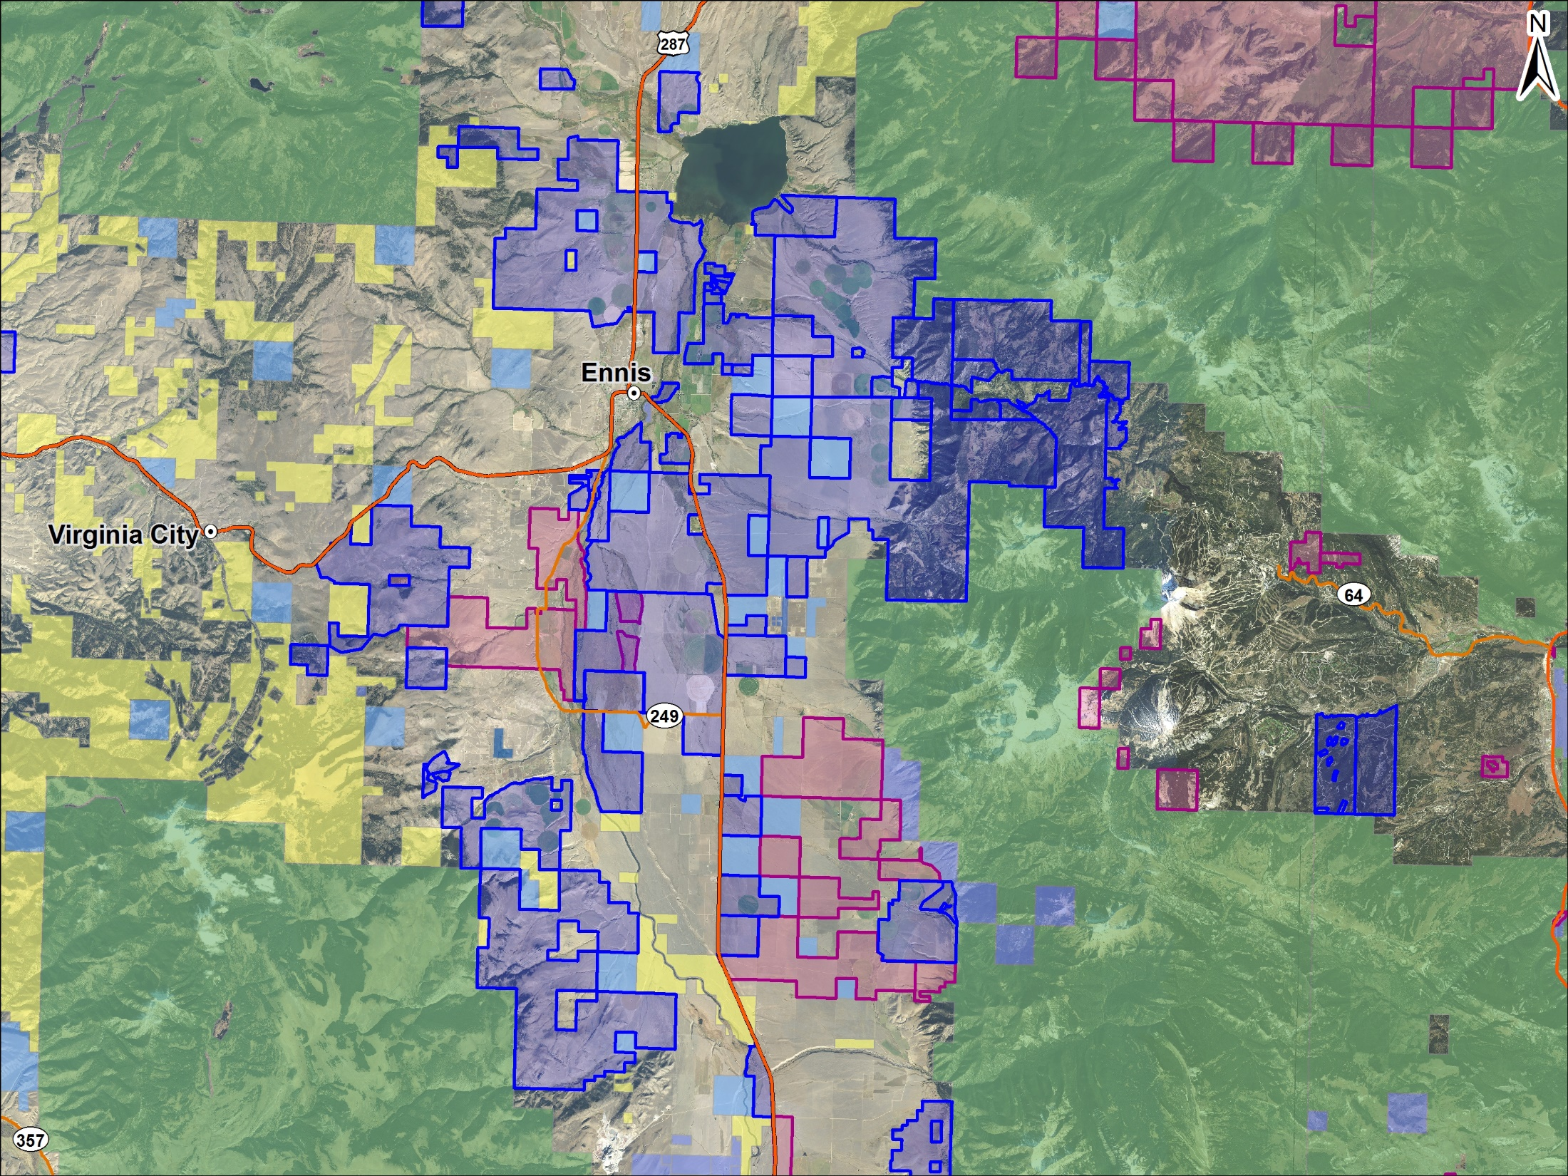

Slide 11
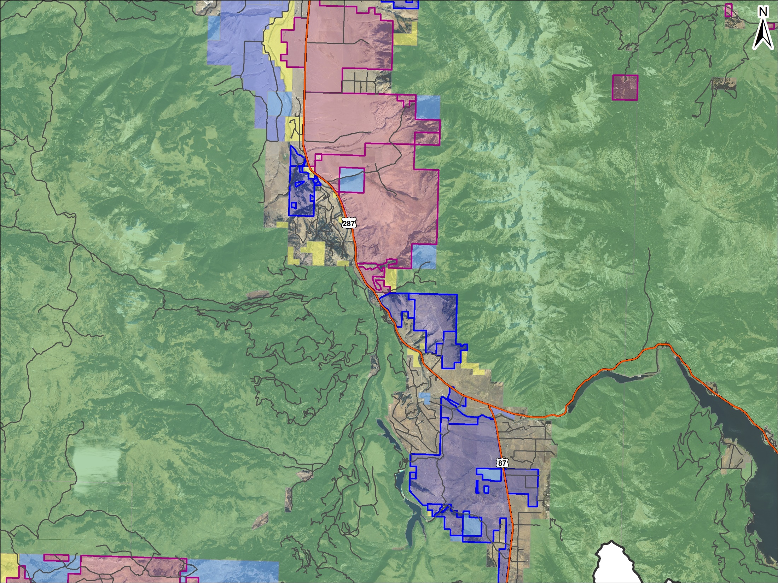

Slide 12
Presentation roadmap
Sample conservation easement transaction
Tax benefits and strategies
How to read a conservation easement deed
Land trust-landowner relationship basics and real estate transactions involving easement properties
Conservation easement amendments and terminations
More awesome pictures
Q&A

Slide 13
Sample project: The Smiths’ on Jack Creek
Landowners: John and Jane Smith
Property: Family recreational and investment property along Jack Creek near Big Sky
Acreage: 400 acres

Slide 14
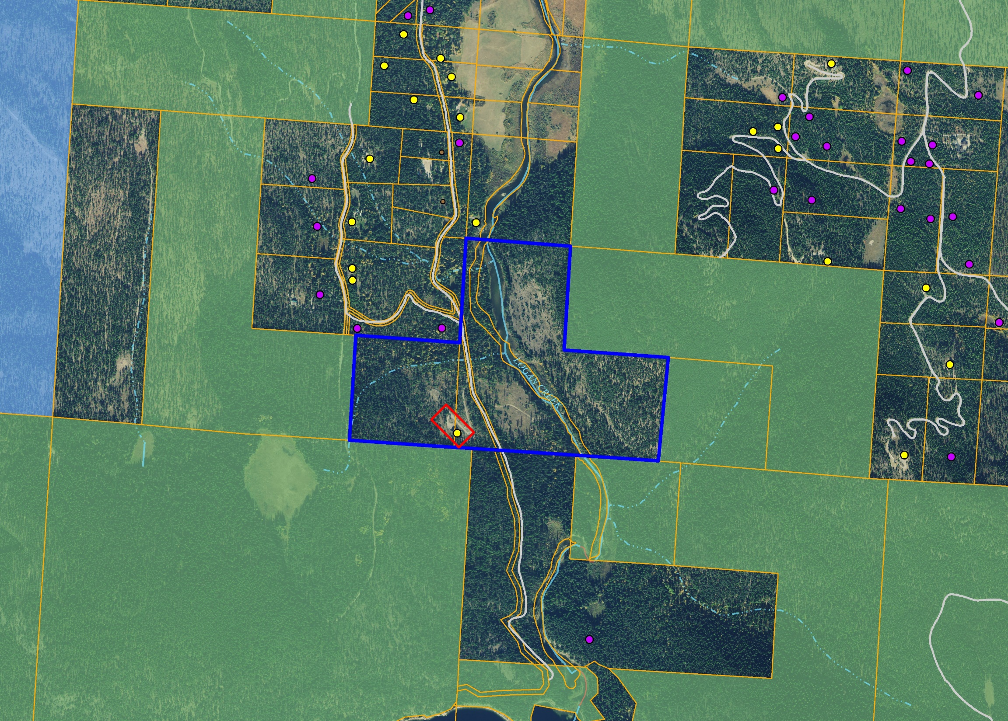
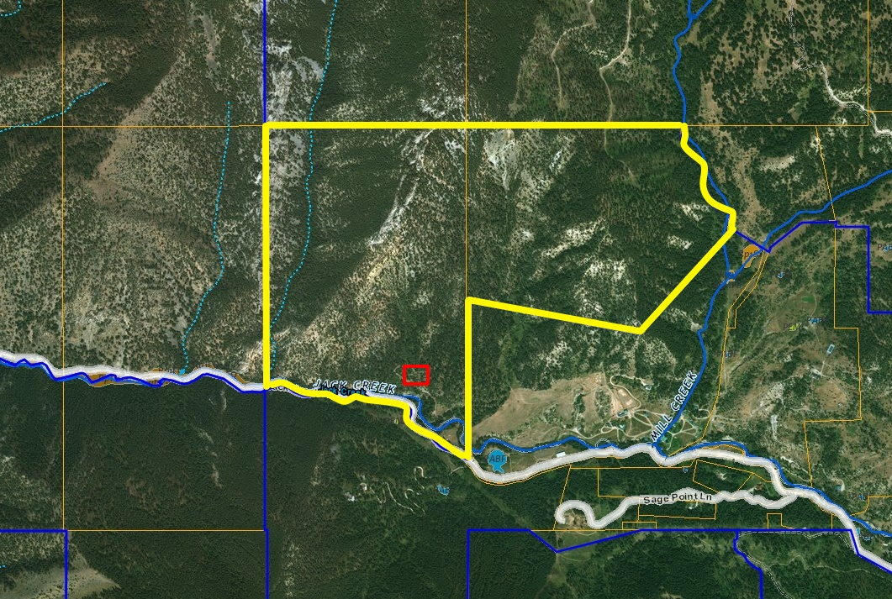

Slide 15
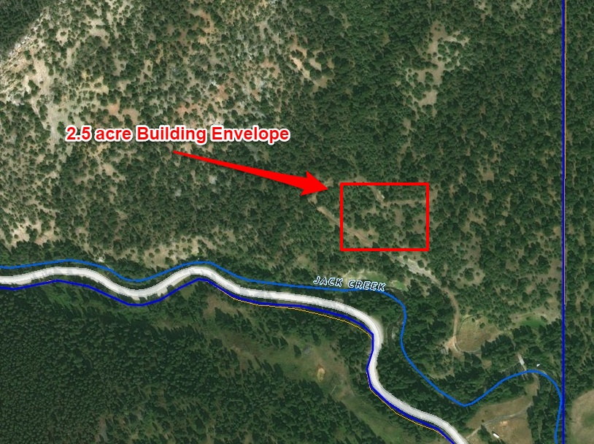

Slide 16
The Smiths’ on Jack Creek
Restrictions placed on property
Permitted uses of the property
Property must transfer as one parcel—no subdivision.
A maximum of two residences can be constructed, which must be located within building envelope.
No mining or commercial timber operations.
Roads can only be constructed for certain purposes.
No large-scale utility infrastructure.
Buffer fencing required for grazing in riparian area.
Agricultural activities, including development of water resources for agricultural purposes.
Commercial hunting, fishing, and outfitting.
Guest ranching and use of the residences for short-term rentals.
Use for educational and scientific purposes.
All uses not specifically prohibited that are compatible with conservation values.

Slide 17
The Smiths’ on Jack Creek (donated)
Unencumbered value: $6,000,000.
Encumbered value: $3,500,000.
John and Jane receive a charitable income tax deduction in the amount of the reduction in value, or $2.5M.
With income of $500k/year and an effective tax rate of 35%, they receive $875k in actual tax savings over the next ten years.
Tax law: contribution deductible up to 50% AGI in year of donation and up to 15 years after. Qualified farmers and ranchers: 100%(!)

Slide 18
The Smiths’ on Jack Quagle Creek (bargain sale)
Unencumbered value: $6,000,000.
Encumbered value: $3,500,000.
Federal ALE funding: $1,250,000.
Gallatin County Open Space: $400,000.
Other private/nonprofit match: $225,000.
Charitable component: $625,000.
John and Jane receive a charitable income tax deduction in the amount of the charitable portion of the transaction, or $625,000.
They will use this to shelter a portion of their $1.875M easement purchase price.

Slide 19
Other Tax Strategies
Estate tax benefits are available
Reduction in value for estate purposes
Easements can be donated post-mortem
2031(c) exclusion
Funds acquired through sale of easements can be used for 1031 exchanges
Amendments further restricting development can qualify for federal income tax deduction
Structure income to qualify as “qualified farmer or rancher” in year of donation

Slide 20
Federal income tax deduction requirements
“Qualified conservation contribution”
“Qualified real property interest”
“Qualified organization”
“Exclusively for conservation purposes”
Donative intent
Qualified appraisal
Protected in perpetuity, which includes:
Ban on surface mining
Restriction on assignability
Restriction on inconsistent uses
Documentation of baseline
Notification and inspection requirements
Mortgage subordination
Extinguishment/right to proceeds

Slide 21
Allowable conservation purposes
170(h)(4) defines conservation purpose as:
(i) the preservation of land areas for outdoor recreation by, or the education of, the general public,
(ii) the protection of a relatively natural habitat of fish, wildlife, or plants, or similar ecosystem,
(iii) the preservation of open space (including farmland and forest land) where such preservation is—
(I) for the scenic enjoyment of the general public, or
(II) pursuant to a clearly delineated Federal, State, or local governmental conservation policy,
and will yield a significant public benefit, or
(iv) the preservation of an historically important land area or a certified historic structure.

Slide 22
How to read a conservation easement
Recitals: identify conservation values protected by easement
Open space supported by government policy
Open space preserving scenic views
Natural habitat
Less common: historic preservation, public access
Very often more than one conservation value protected.

Slide 23
How to read a conservation easement
Permitted uses section
Specifies what uses of the property are expressly permitted.
Typically addresses:
Any rights to subdivide the property
Any rights to construct structures and improvements: where, how many, number of residences, outbuildings, and any notice and approval requirements
Roads
Utilities
Commercial activities
Sub-surface mineral development
Timber harvest
Agricultural activities
Habitat protections
Pay special attention to reserved rights that must be designated as part of transfer of a portion of easement property. Critical to understand what rights go with the property you are buying or selling.

Slide 24
How to read a conservation easement
Prohibited uses section
Specifies what uses of the property are expressly prohibited.
Typically addresses:
Subdivision
Construction
Dumping
Roads and utilities
Timber harvest
Commercial activities
Sub-surface mineral development
Surface alteration
The “flip side” of many items specified in the permitted uses section.
Tracks with protection of conservation values identified in recitals.

Slide 25
Land trust-landowner relationship basics
Monitoring
IRS requirement
Typically annual, in-person meeting between land trust monitoring staff and landowner (or landowner’s designated representative)
Ensures all terms of conservation easement are being followed
A great opportunity to exchange ideas and ask questions
Enforcement
Hopefully never necessary!
Approaches range from speedy mutual resolution up to and including litigation.
Land trust is obligated to enforce easements to keep its tax-exempt status.

Slide 26
Land trust-landowner relationship basics
Notice-and-approval provisions
Easements are largely “hands off” but read easement carefully—these may be present.
Examples include:
Requiring notice and approval to designate building envelopes
Requiring notice and approval to construct some or all structures
Approval to build roads or utilities
Agreement on grazing/management plan
Agreement on timber harvest plans
Notification if mineral development is to occur
ALE plans

Slide 27
Real estate transactions involving easement properties
Land trusts are not parties to real estate transactions involving easement properties.
This means land trusts typically cannot make representations or warranties to prospective purchasers regarding the conservation easement. Land trusts typically never provide easement interpretations to anyone but the landowner, but this is especially so in the case of a potential real estate transaction. Amendments cannot be discussed with anyone but the landowner.
Potential solution: read the easement! (Or ask seller to ask land trust for interpretation.) Consult an attorney familiar with conservation easements on meaning of easement terms.
Read the easement!

Slide 28
Real estate transactions involving easement properties
Conservation easement properties will be less expensive than comparable unencumbered properties, so they may be very attractive if the buyer is comfortable with the easement’s restrictions.
Many easement properties are in “conservation neighborhoods” that avoid the potential for views or habitat to be negatively affected by future development. MLR’s website has a helpful “Conservation Atlas” tool: www.mtlandreliance.org
Properties well-suited for conservation without an easement offer the potential for a future income tax benefit for prospective buyers. Land trusts may be able to offer preliminary thoughts on the potential for a successful project.

Slide 29
Amendment of conservation easements
Conservation easements are very, very rarely amended. They are never terminated.
Prospective purchasers of conservation easement property should never decide to purchase a property if they cannot live with the easement as written. The land trust is not obligated to agree to an amendment request and the IRS takes an extremely aggressive approach to whether amendments are permissible.
Amendments can be costly and time-consuming, even if the proposal is ultimately rejected.
Successful amendments typically involve adding acreage to the easement and/or eliminating reserved rights to subdivide or develop the property.

Slide 30
Amendment of conservation easements
The Land Trust Alliance’s Model Conservation Easement allows the donor and donee organization to amend the easement jointly, provided the amendments are:
consistent with the purposes of the easement,
do not affect the status or qualification of the easement or the easement holder under applicable laws, including federal income tax laws, and
do not affect the perpetual duration of the easement.
Three primary areas of focus:
Impact of amendment on conservation values
Potential for impermissible private benefit
Worth the time and effort for the land trust?

Slide 35
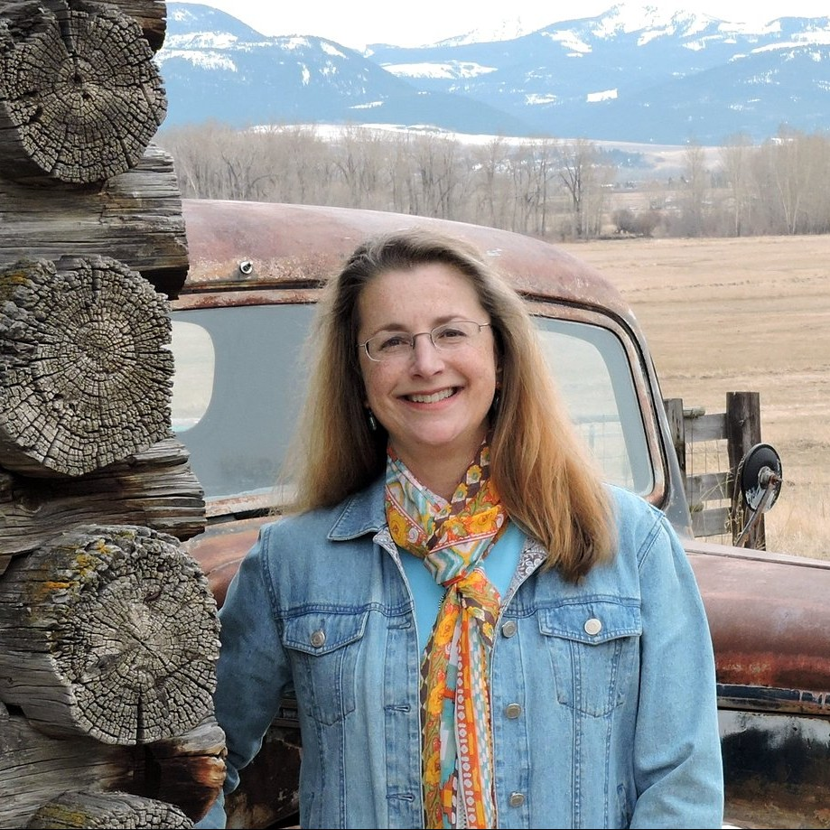
MLR folks you might be talking to!
Jessie Wiese
Southwest Manager
Kathryn Kelly
Greater Yellowstone Manager
Will Trimbath
Lands Manager
…or one of MLR’s 16 seasonal land stewards.

Slide 36
Thank you!
Contact info:
christiandietrichlaw@gmail.com
(406)465-5946
Work:
christian@mtlandreliance.org
(406)443-7027

