Slide 1
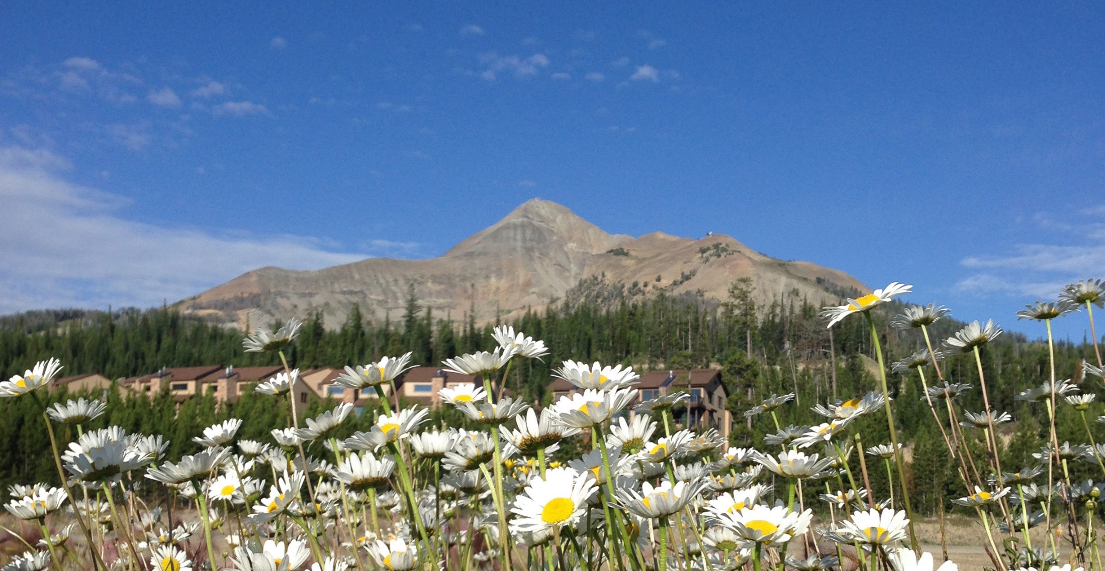
Invasive Plant Species

Slide 2
Gallatin Invasive Species Alliance
The Gallatin Invasive Species Alliance
is a locally led not-for-profit 501(c)(3) organization
working to conserve native plants, wildlife habitat, and water resources through invasive species education and management.

Slide 3
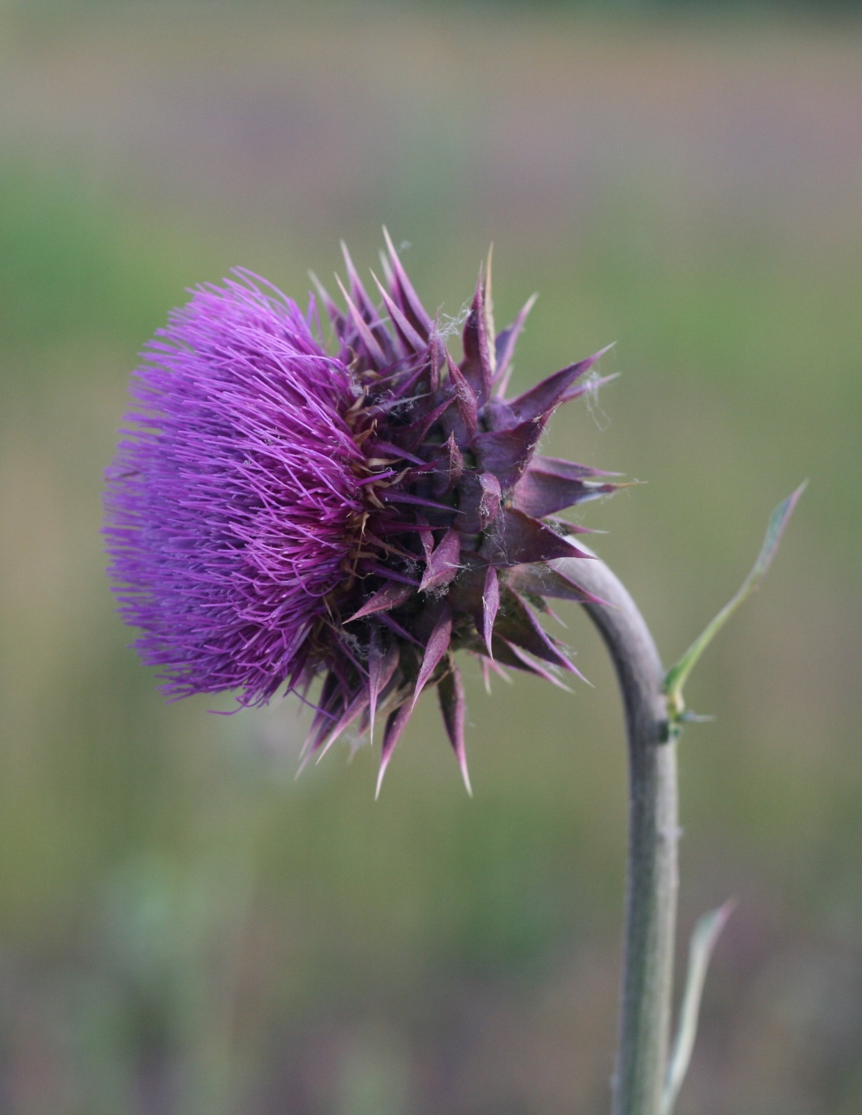
Why Should I Care?
Noxious weeds have widespread impacts:
· Replace native plant communities
· Increase soil erosion
· Degrade water quality
· Damage fish & wildlife habitat
· Decrease the value of land
· Reduce recreation & hunting opportunities
· Increase maintenance costs - including trails
· Diminish recreational experiences

Slide 4
Habitat Transformers
Noxious weeds like spotted knapweed are known as “habitat transformers” because they change the physical structure and forage availability in habitats, eventually pushing resident wildlife out.

Slide 5
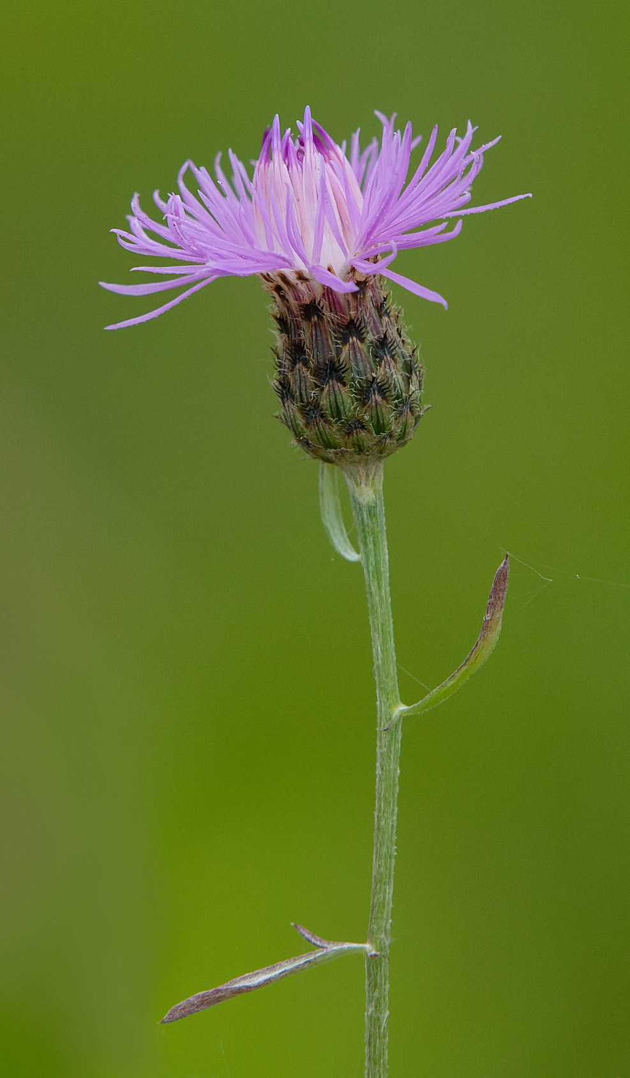
Some Facts About Spotted Knapweed
1 spotted knapweed plant can produce 300 flower heads / 140,000 seeds
Seeds can remain viable for 8 years, if not longer
Infestations of up to 2 million plants per acre are not uncommon
In one study in Montana, dense populations of spotted knapweed were found to reduce available winter forage for elk by 50 to 90 percent. If noxious weeds win, wildlife lose.

Slide 6
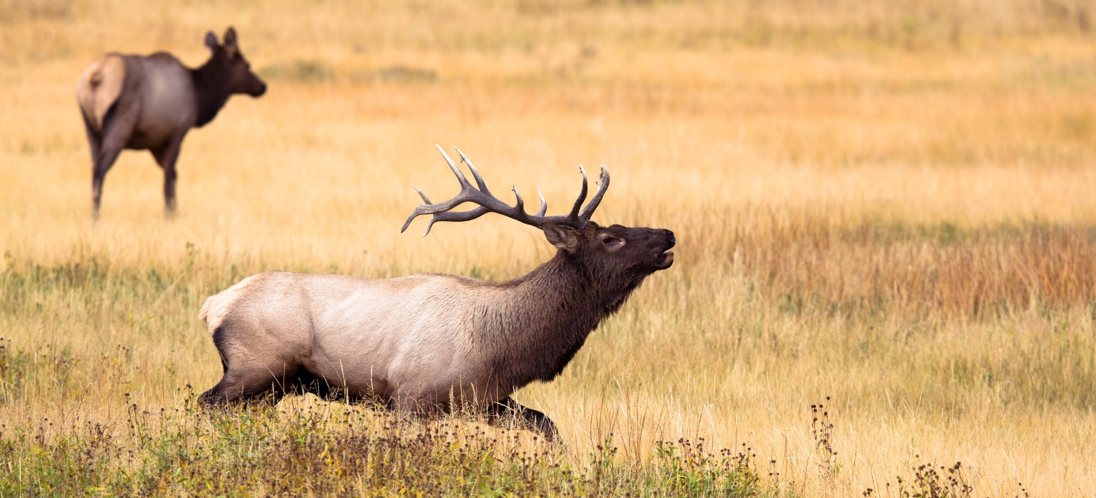
Impacts on Wildlife
· Reduced forage: spotted knapweed can reduce available winter forage for elk by 50-90%
· Altered thermal and escape cover
· Reduced territorial space necessary for wildlife survival
· Disrupted seasonal distribution patterns

Slide 7
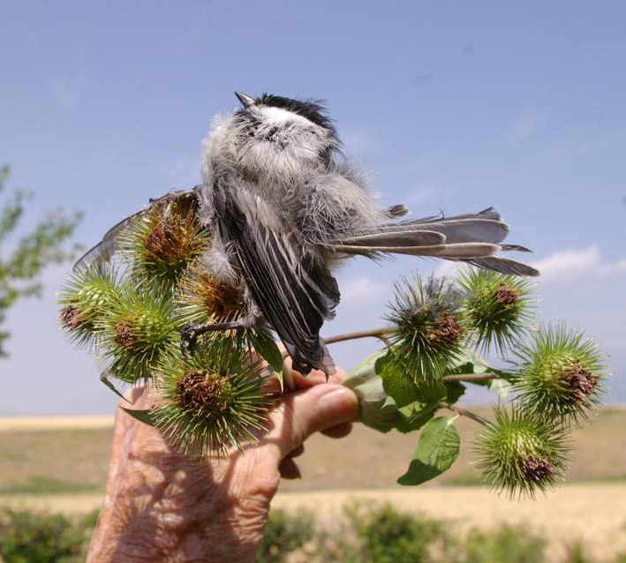
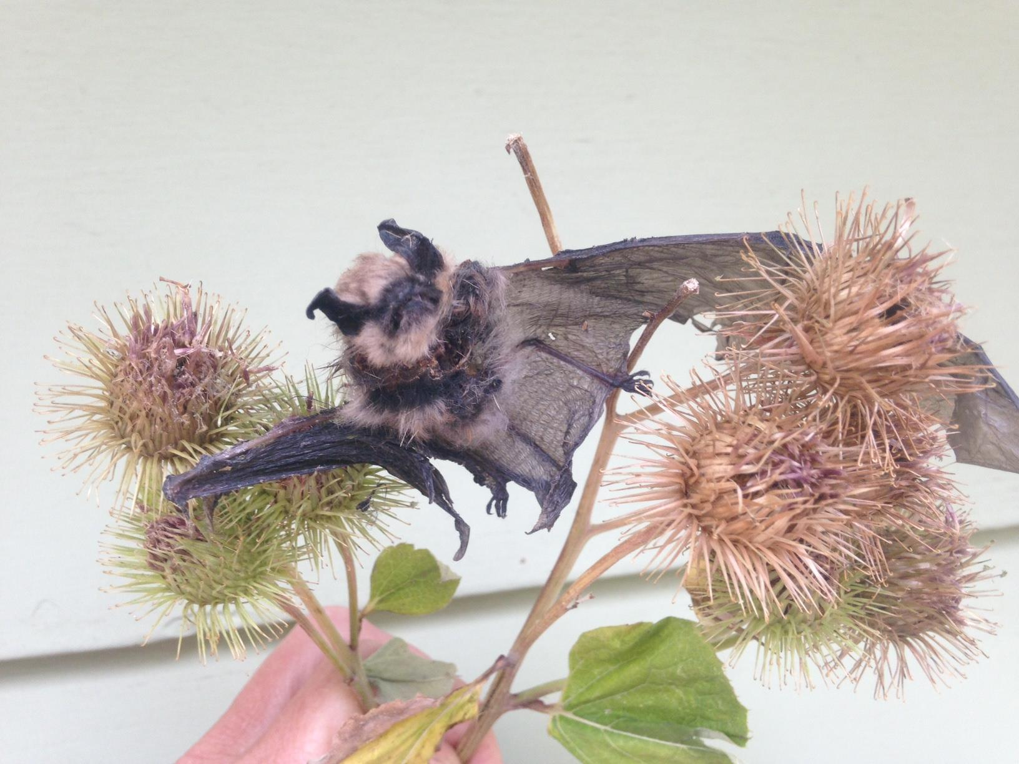
Weeds Can Kill
Photo by Paulette Epple at Headwaters State Park
Photo by Norman Bishop near Sypes Canyon

Slide 8
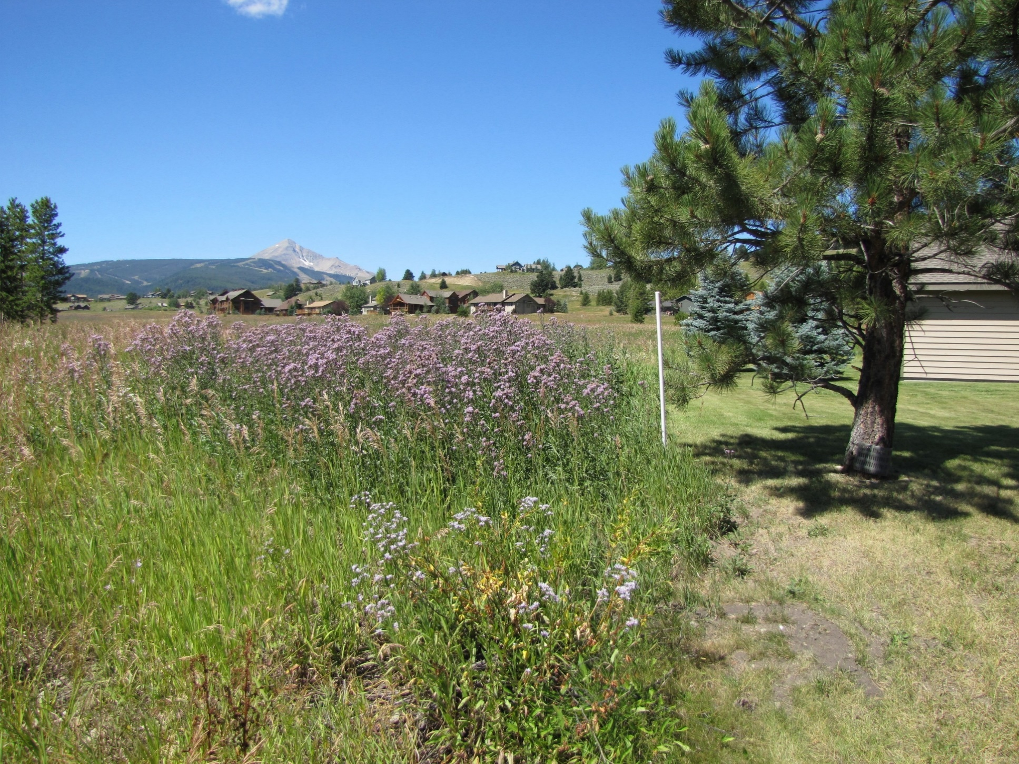
Landowners & Community
Reduction of land value –
North Dakota ranch infested with leafy spurge - drop in value of 60%.
Oregon ranch - drop in value from $170,000 to $27,500 shows a loss of approximately 83% in value on this ranch.
Increased resources (time and money) to manage
Inaction by one landowner negatively affects adjacent landowners
Degradation of aesthetic values

Slide 9
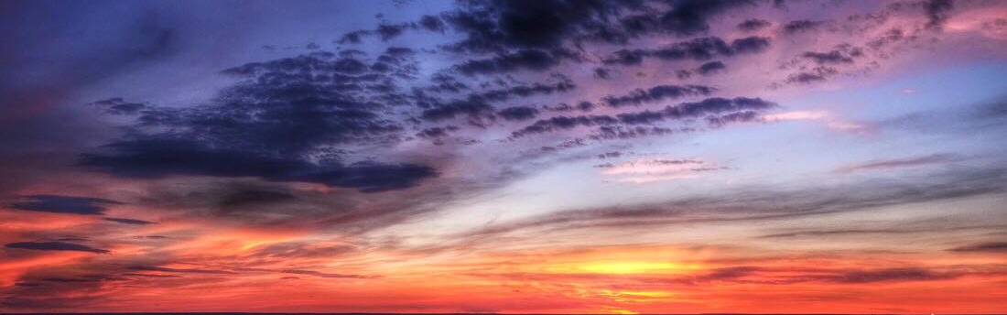
Big Picture
“Resource managers everywhere recognize that invasive non-native species are the biggest threat to the integrity and function of terrestrial and aquatic environments. The Gallatin watershed is no exception. Over several decades of resources management, I have seen landscapes recover from every type of calamity but I have never seen a landscape recover from the introduction of invasive species.”
John Councilman, Retired Gallatin National Forest Vegetation Management Specialist

Slide 10
What are noxious weeds?
Plants species that are deemed to be invasive and possess the capacity to negatively impact the state's natural vegetation communities and agricultural lands.
Noxious Weeds are defined in state law as exotic species which may render land unfit for agriculture, forestry, livestock, wildlife, or other beneficial uses or that may harm native plant communities and are determined by Rule of the Montana Department of Agriculture (MDA) under the provisions of the Montana County Weed Control Act.
Individual counties may further designate species as Noxious Weeds in their respective jurisdictions.

Slide 11
Your Opportunity: Buy/Sell
Buy/sell agreements should include a noxious weed disclosure which alerts buyers to the issue of noxious weeds and their responsibility to control them on their property.
When property is offered for sale, the person who owns the property shall notify the owner’s agent and the purchaser that: noxious weed infestations occur on the property and the buyer and buyer’s agent should be notified whether or not a noxious weed management plan is on file with the county.
So, as a realtor, you do not need to be an expert in noxious weeds and integrated management to be of service to your clients. Instead, you can be of service simply by making them aware of the issue of noxious weeds and directing them to local experts for more information if noxious weeds are present on the property.
If you have knowledge of the noxious weed infestations present on the property, you have the power to negotiate a better deal.
Dealing with a severe noxious weed infestation can reduce property value and take many years and large amounts of money to get under control.
While looking over potential properties, it does not hurt to observe the weed situation of surrounding properties as well.

Slide 12
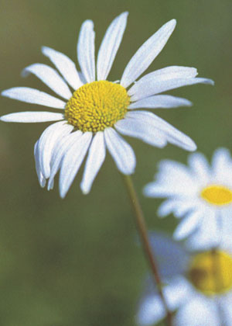
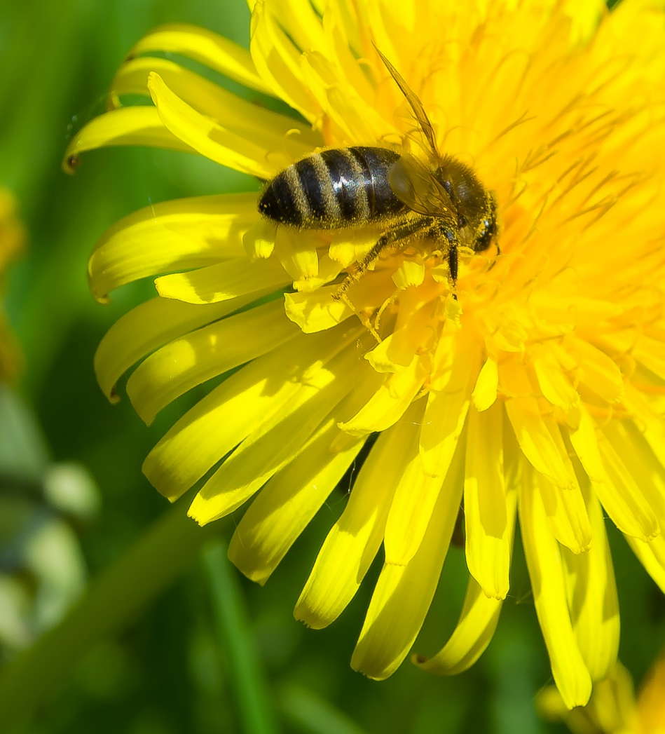
Noxious vs Nuisance Weed
Oxeye Daisy Dandelion

Slide 13
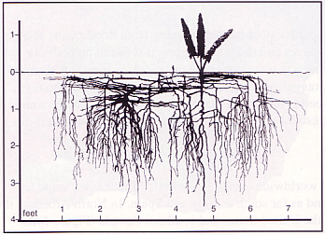
The 3 D’s of Noxious Weeds
Damaging to the economy or environment
Difficult to control
Tend to Dominate a site
Image: MSU Extension Bulletin 134

Slide 14
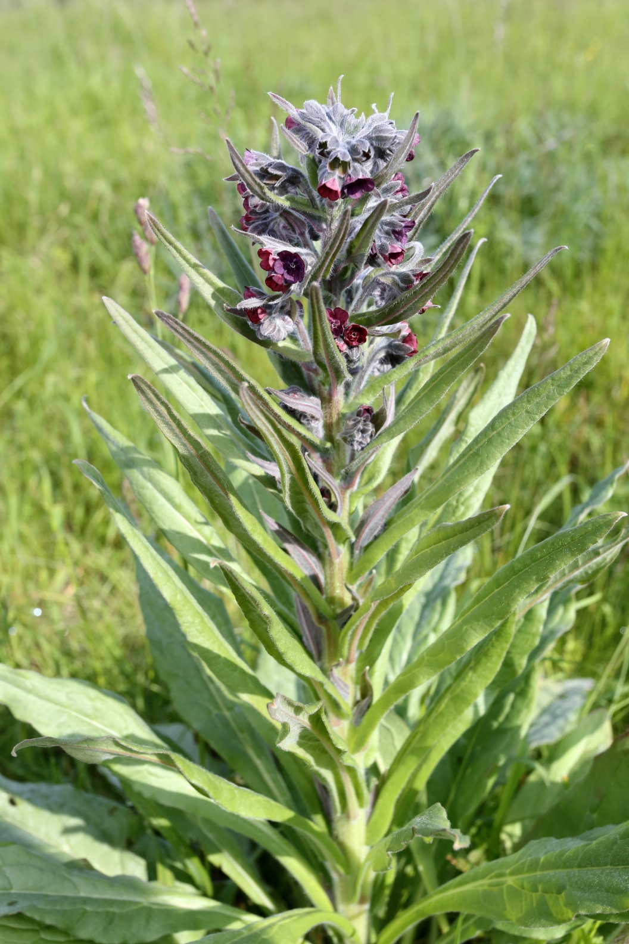
Step 1 - Identification
Montana Weed Control Association
www.mtweed.org
Gallatin County Weed District
Gallatin Invasive Species Alliance
www.gallatinisa.org

Slide 15
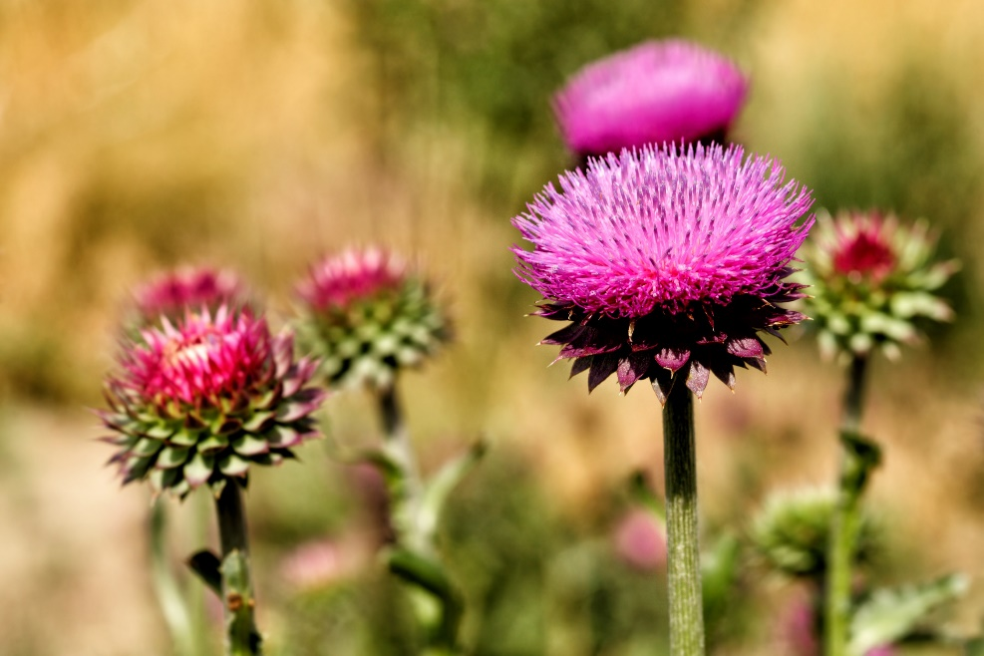
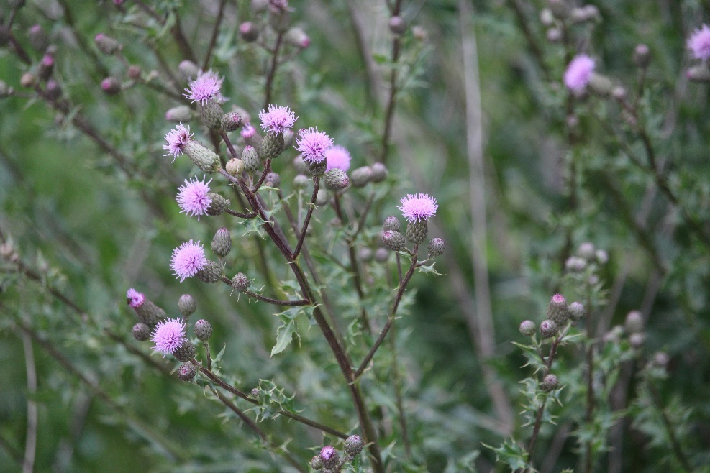
Step 2 - Understand Weed Biology
Annual
One season for all stages of development
Produce foliage, flower seeds, then die
Biennials
Require two seasons for completion of life cycle
First year: develop roots and low-growing leaves
Second year: flowers, sets seed and matures
Examples are houndstounge & musk thistle
Perennials
Live more than two years
Will produce foliage, seed, and reach maturity year after year
Examples are leafy spurge and Canada thistle
Musk Thistle - biennial
Canada Thistle - perennial

Slide 16
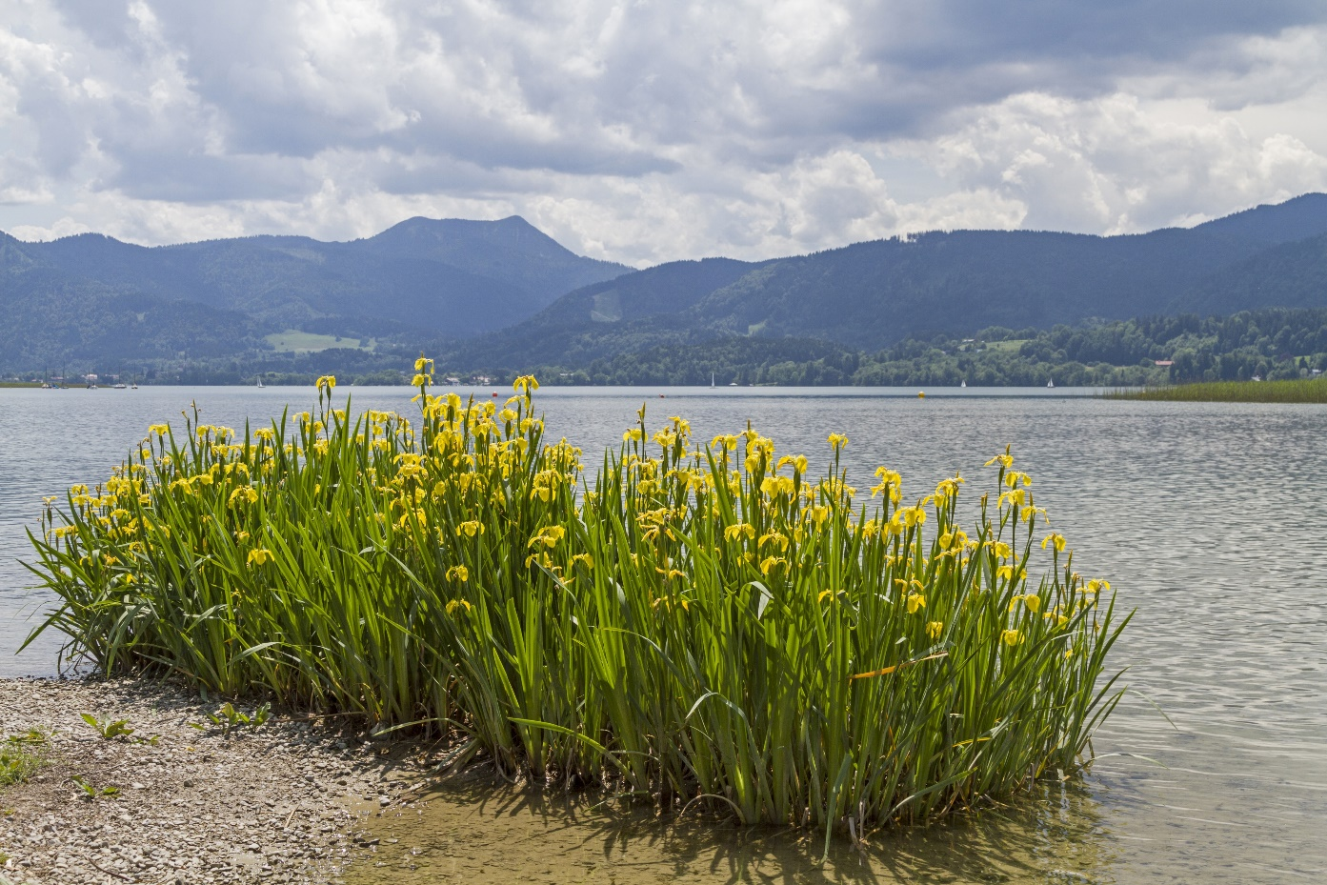
Step 3: Understand Weed Management
Prevention is the first line of defense to keep weeds from occurring or increasing.
Eradication is the removal of weeds from an area so they will not recur unless reintroduced.
Control reduces a weed population to a manageable level
Noxious weed reality check:
In general, it takes several years of repeated management to reduce or eliminate the population.

Slide 17
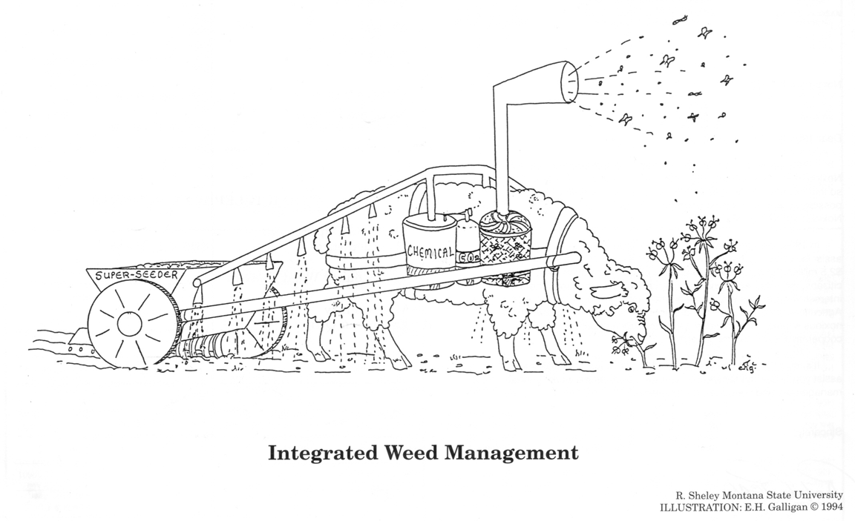
Control
Mechanical control
Biological control
Cultural control
Chemical control

Slide 18
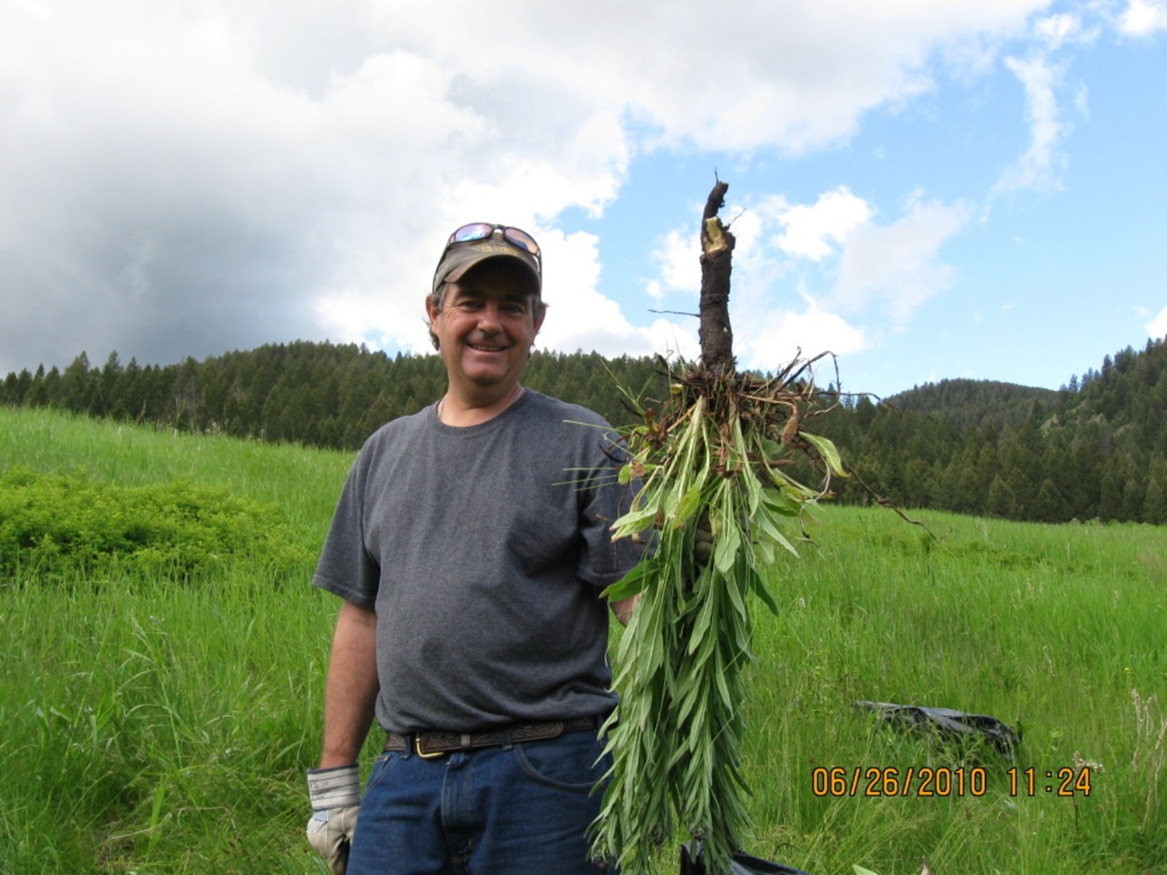
Mechanical Treatments
Cultivation/tillage
Hoeing
Burning
Mowing
Hand-pulling – always wear gloves & bag those weeds!! Best for tap rooted plants.

Slide 19
Mowing Weeds
Weeds can adapt to mowing…and even be encouraged to spread!!!
Canada thistle & leafy spurge send up more tillers, spotted knapweed adapts by spreading low to the ground.
The best time to mow is just before the target weed reaches the flowering stage (reduces seed production & seed bank)
If already gone to seed, you may be spreading the weed seeds around!
A combination of mowing and spraying can be a good 1-2 punch!
Don’t mow lower than 3-4 inches, as you’ll set your grasses back

Slide 20
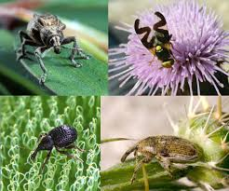
Biological Treatments
Biological control is the use of one organism to suppress another.
They are “stressing agents”, not “killers”.
More effective in combination with other treatment
Can reduce herbicide use
Goal is not total elimination, just to lower general equilibrium
Slower acting control
Great for areas where spraying is not an option: wetlands, riparian areas, steep slopes

Slide 21
Cultural Control
Using prevention, competition, and land use to reduce reproductive and competitive abilities of noxious weeds.
Minimize disturbance
Use weed free – seed, forage, & gravel
Protect healthy vegetation
Revegetation – necessary on disturbed ground

Slide 22
Chemical Treatment
Fast acting
Can have residual control
Selective or non selective
Use correct product for the species and the site treated
Always read the label
Always wear protective clothing:
Eye protection
Long sleeve shirt
Chemical resistant gloves
Long pants
Rubber boots

Slide 23
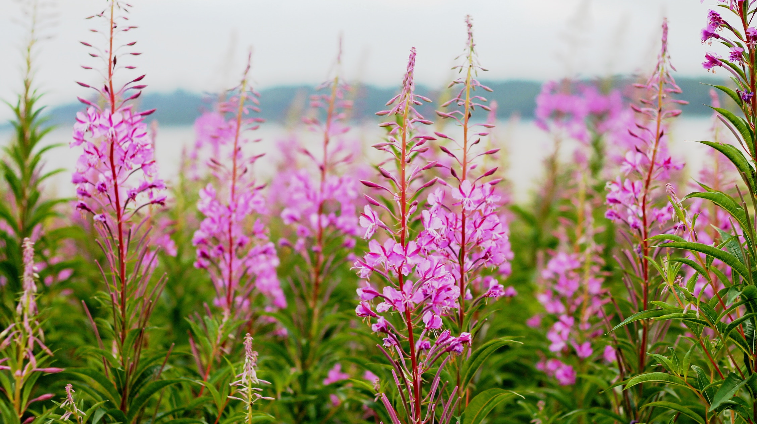
Adaptive Management
Successful weed management requires constant vigilance!
Successful weed eradication requires yearly treatment for many years.

Slide 24
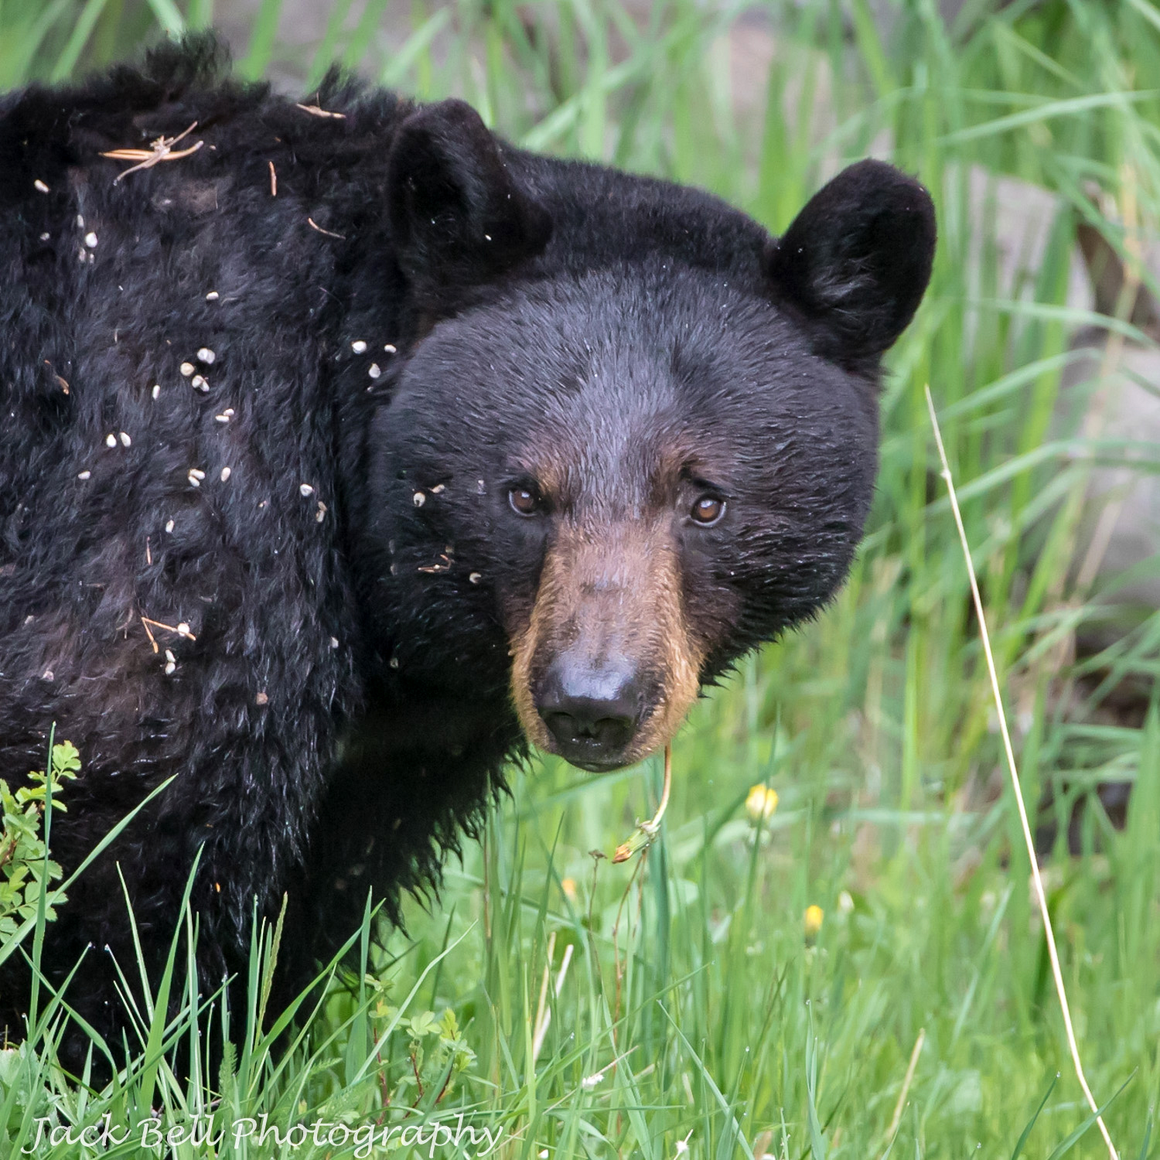
Most Common Noxious Weeds of 2017
1. Canada thistle
2. Oxeye daisy
3. Hoary alyssum
4. Houndstongue
5. Musk thistle
6. Spotted knapweed
7. Bull thistle
8. Common tansy
9. Poison hemlock
10. Yellow toadflax

Slide 25
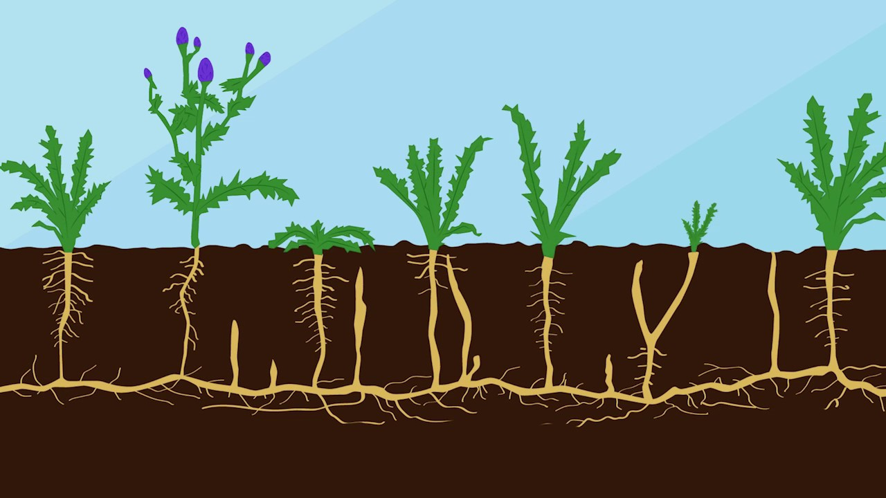
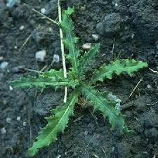
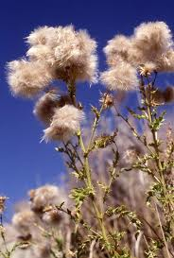
Canada thistle (Cirsium arvense)
Colony-forming perennial
Reproduces vegetatively by rhizomatous roots or by seeds
Leaves are spine-tipped and wavy
Flowers are both male and female on separate plants

Slide 26
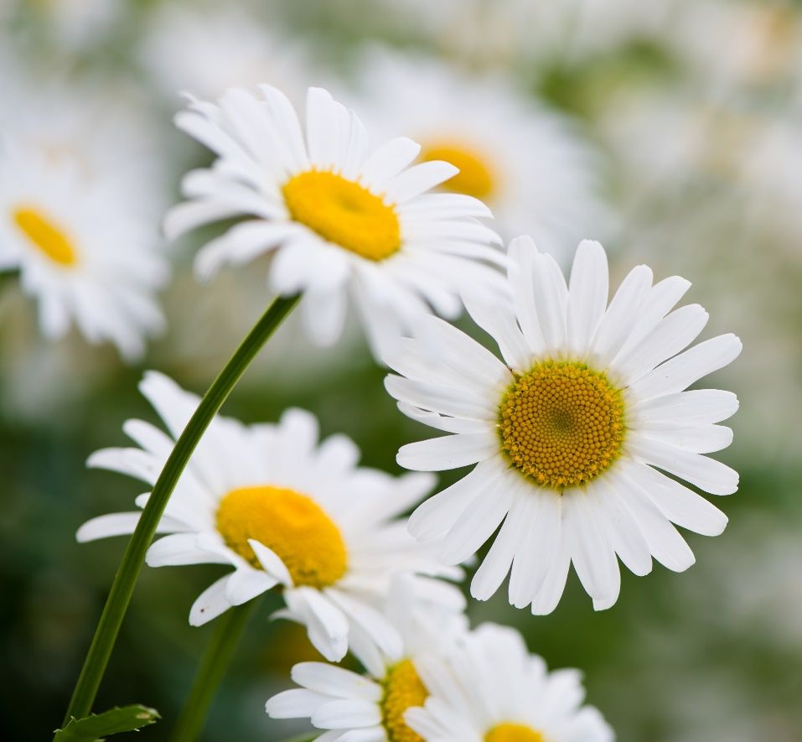
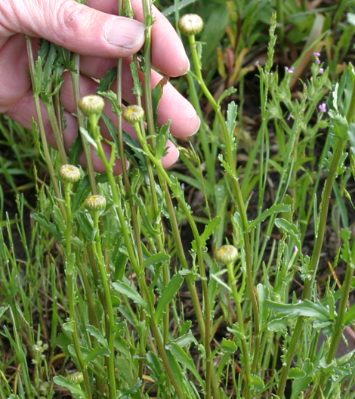
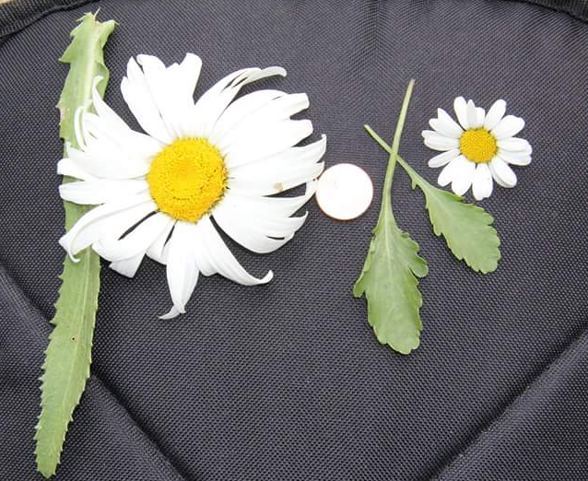
Oxeye daisy (Chrysanthemum leucanthemum)
Perennial
Reproduces by seed or by rhizomes (extensive root system)
Numerous stems, single flower on each stem
Spoon-shaped lower leaves; upper leaves clasp the stem and decrease as they go up the stem
White, showy daisy flower with yellow center
Height 1 to 3 feet
Shasta Daisey on left, Oxeye daisy on right

Slide 27
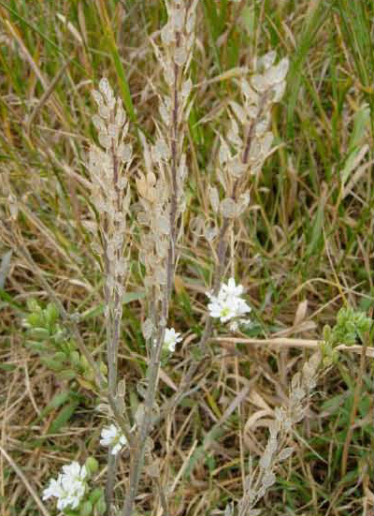
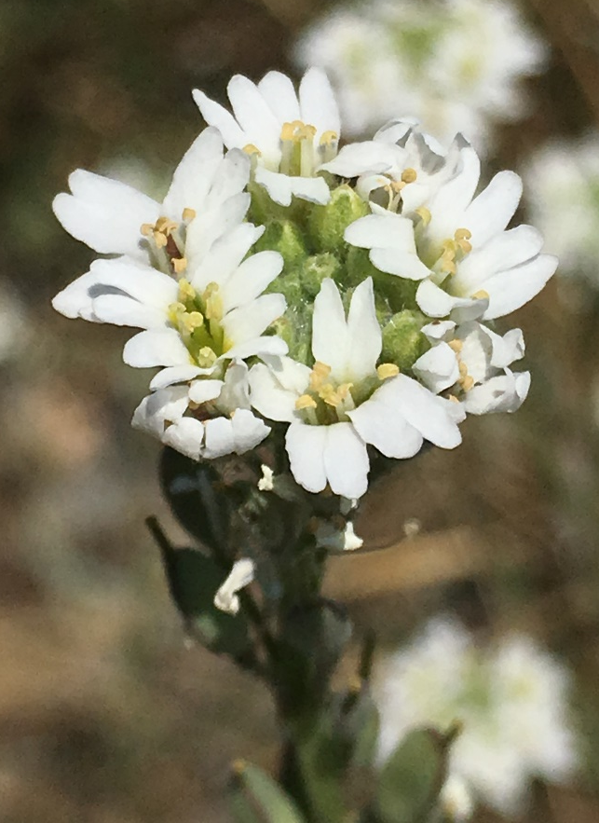
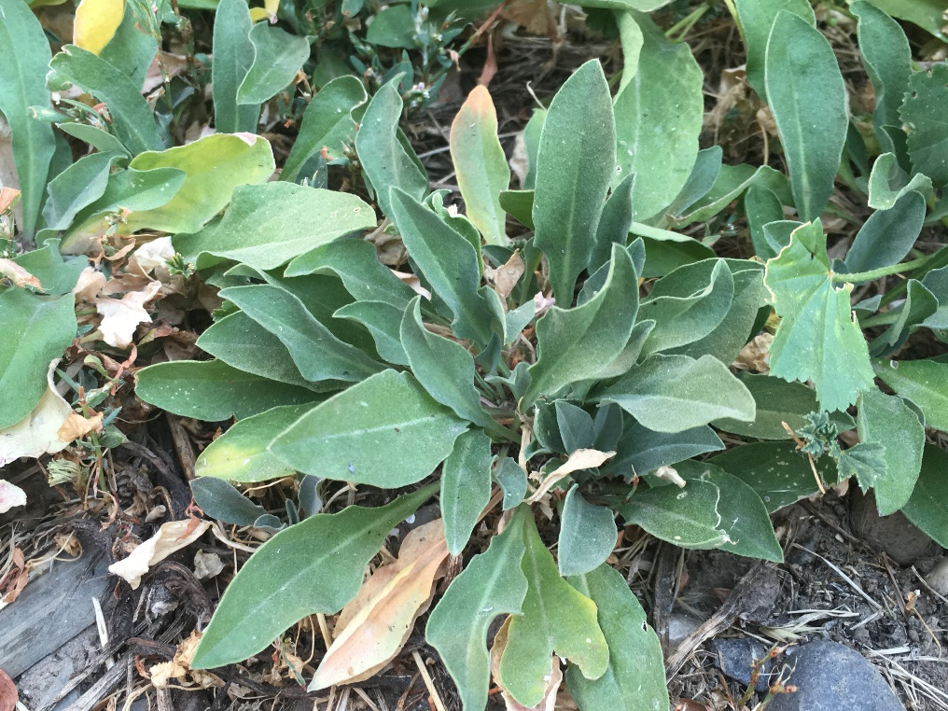
Hoary alyssum (Berteroa incana)
Annual or perennial
Tap root
“Hoary” silver color from short, star-shaped hairs covering entire plant
Grayish-colored leaves with sandpaper-like leaf texture
4-petal white flower with notched petal tips = rabbit ears
Reproduces from seeds - viable in the soil for up to nine years
Toxic to horses – even in cured hay

Slide 28
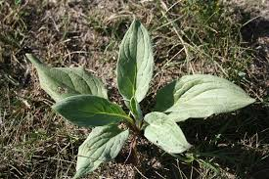
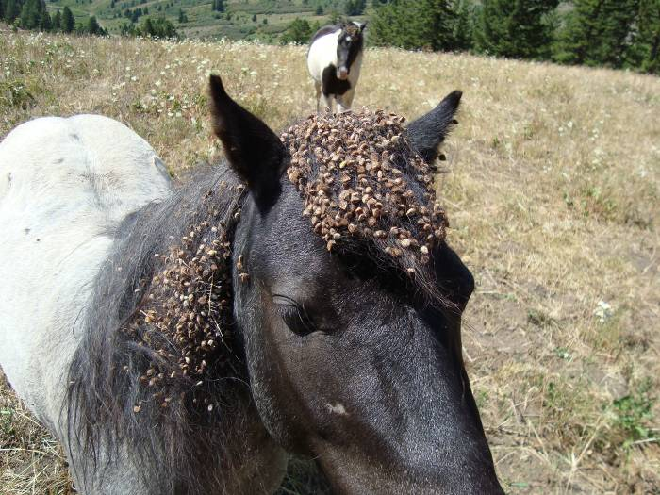
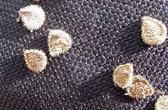
Houndstongue (Cynoglossum officinale)
Biennial forb with a tap root
Velvety rosette leaves with smooth edges and defined veins
Reddish-purple flowers with 5 petals
Burr-like adhesive nutlets/seeds
Height 8 to 30 inches
Toxic to horses, cattle, sheep and goats.

Slide 29
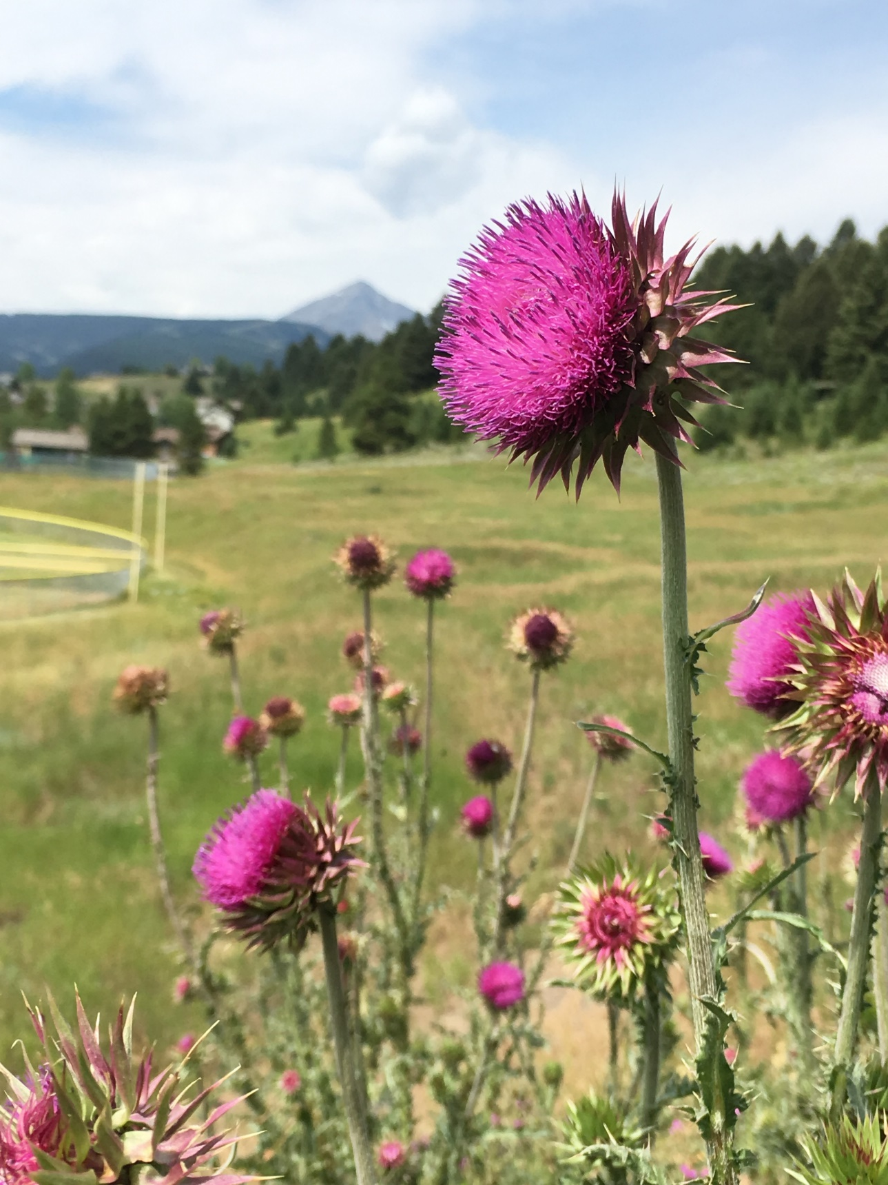
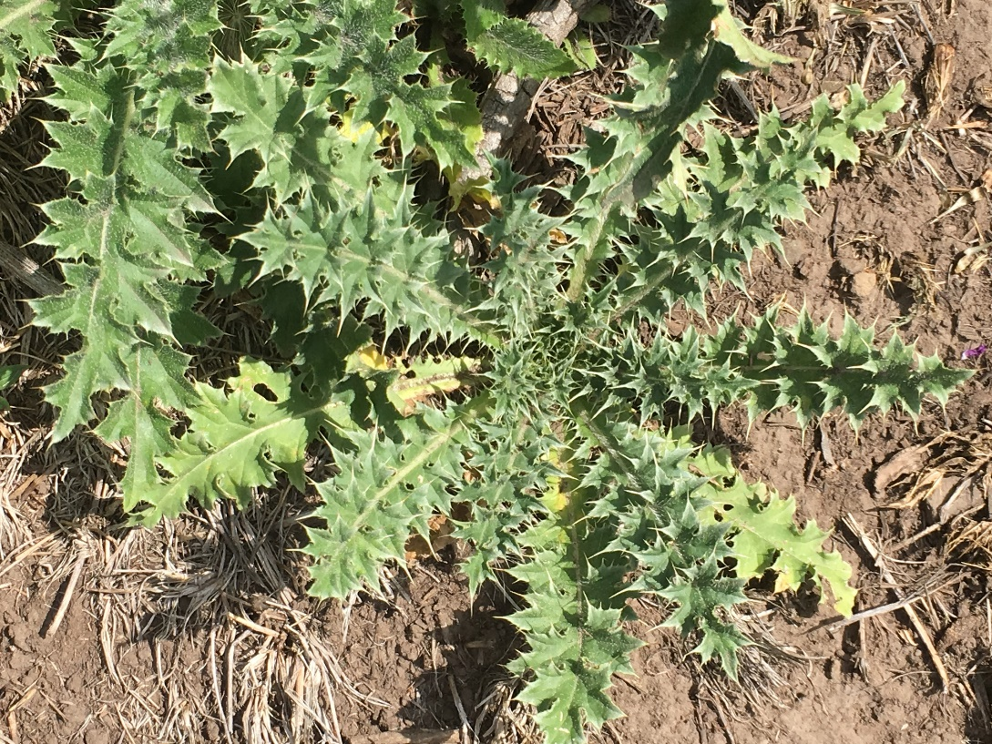
Musk thistle (Carduus nutans)
Biennial, perennial forb that grows 3-6 feet tall.
Numerous flower heads, 1.5” to 3”, with spine-tipped bracts, droop on the stem when fully developed, giving musk thistle its other common name, “nodding thistle.”
Reproduction is only by seed, carried by the wind. One plant can produce up to 20,000 seeds, and seeds can remain viable for up to 10 years.

Slide 30
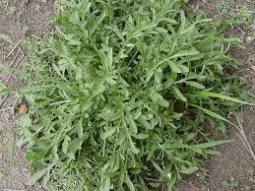
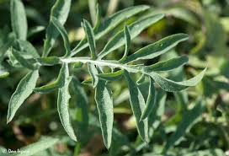
Spotted knapweed (Centaurea maculosa)
Short lived perennial, sometimes biennial
Taproot
Rosette leaves deeply loped, linear mature leaves.
A single pink to purple flowerhead at end of stem
Floral bracts are tipped with dark comb-like fringe
Plants are suspected to contain toxins that inhibit the growth of neighboring plants.
Seeds remain viable in the soil for up to eight years.

Slide 31
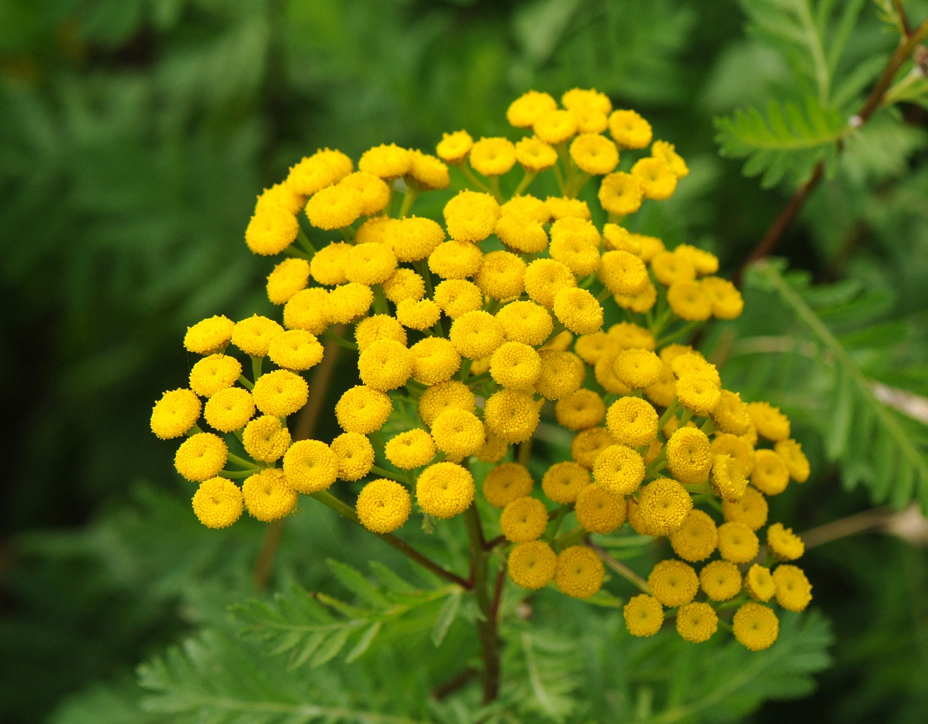
Common Tansy ( Tanacetum vulgare )
Perennial
Extensive, spreading root system.
Stems reddish-purple
Fern-like leaves, when crushed are strongly aromatic; furry on the underside and smooth above
Bright yellow button-flower clusters
Height 1 to 6 feet
Can cause abortions in humans if ingested; will cause liver damage in some livestock, but it is largely palatable.

Slide 32
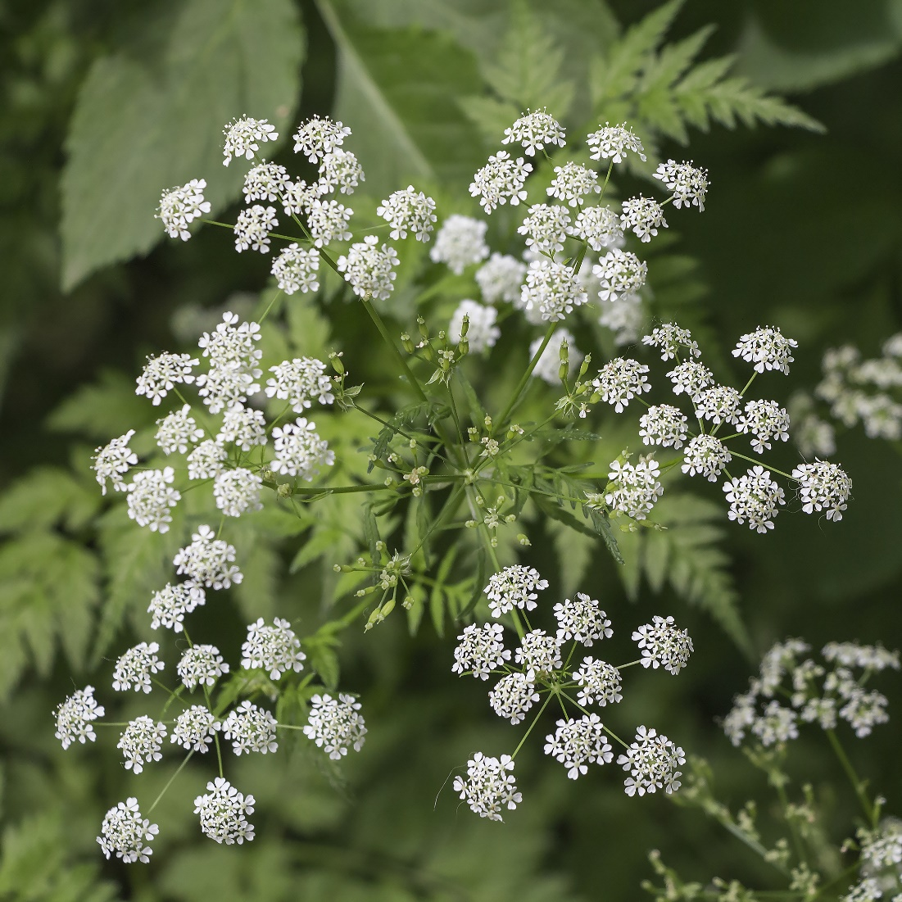
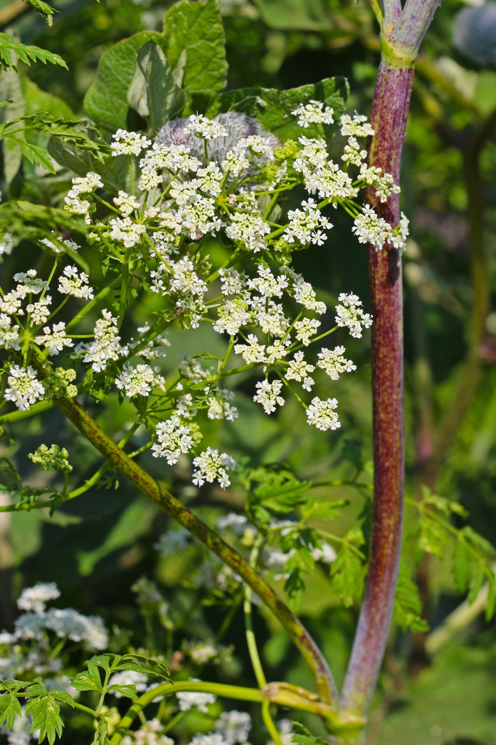
Poison Hemlock (Conium maculatum)
Biennial
Taproot
Small, white flowers are in umbrella-like clusters
Leaves are shiny green, triangular, highly dissected, and fern-like with a strong, musty smelling odor
Hollow stems, with purple spots on lower portions
Reproduces by seed only, and seeds remain viable for up to 6 years
Toxic to all classes of livestock and humans, and all plant parts are poisonous. It was used to poison Socrates.

Slide 33
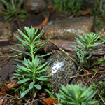
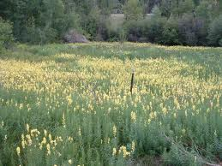
Yellow toadflax (Linaria vulgaria)
Perennial
Reproduces by seeds and underground rootstalks
Narrow, pale green leaves pointed at both ends with smooth edges
Yellow flower with snapdragon-like orange throat; dense clusters

Slide 34
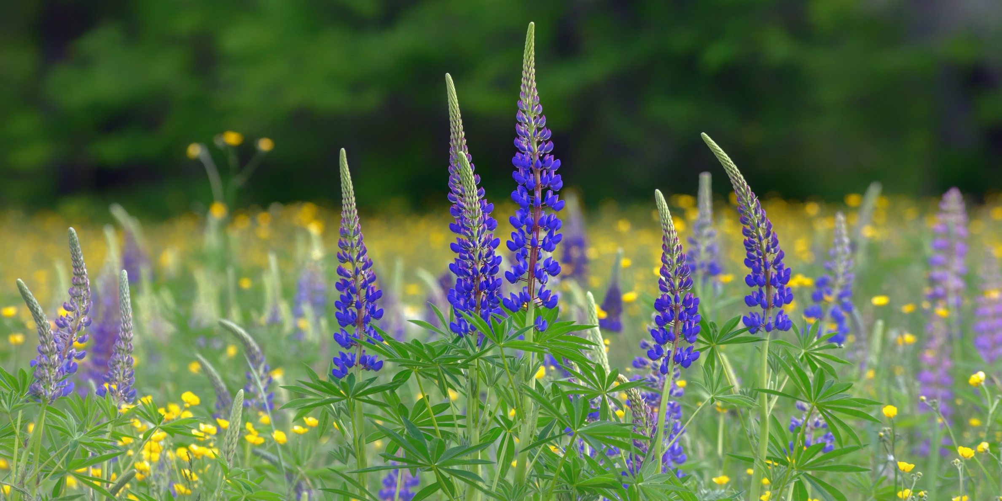
Healthy Ecosystems
A healthy stand of desirable / native vegetation is your best defense against weeds! The mark of a healthy landscape is species diversity:
grasses, forbs, shrubs, trees

Slide 35
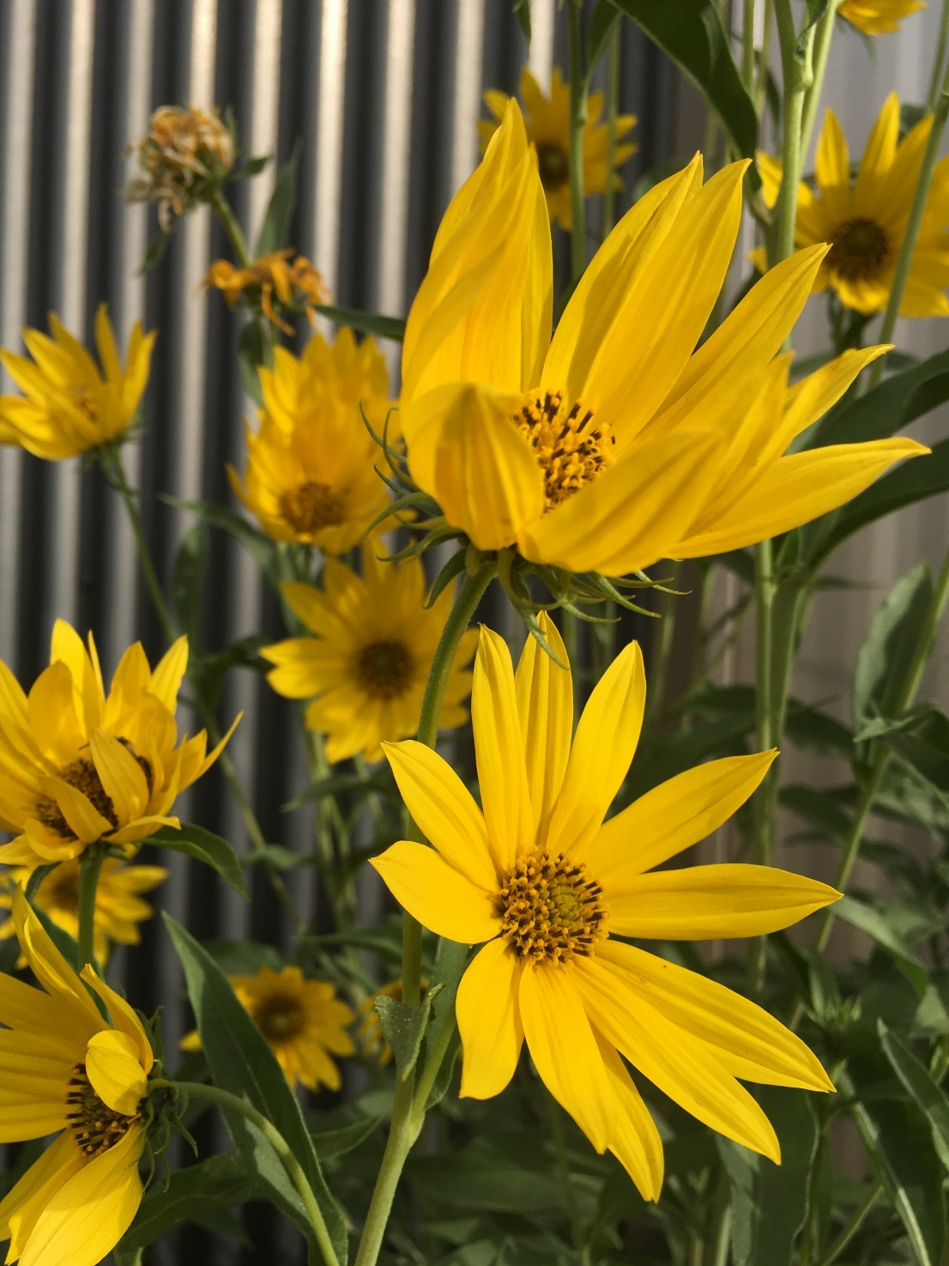
Xeriscape
It integrates the principals of several conservation initiatives such as:
Reducing water, energy, and chemical usage
Reducing maintenance (cost & time)
Enhances wildlife habitat
Improves invasive weed management
Promotes native plants

Slide 36
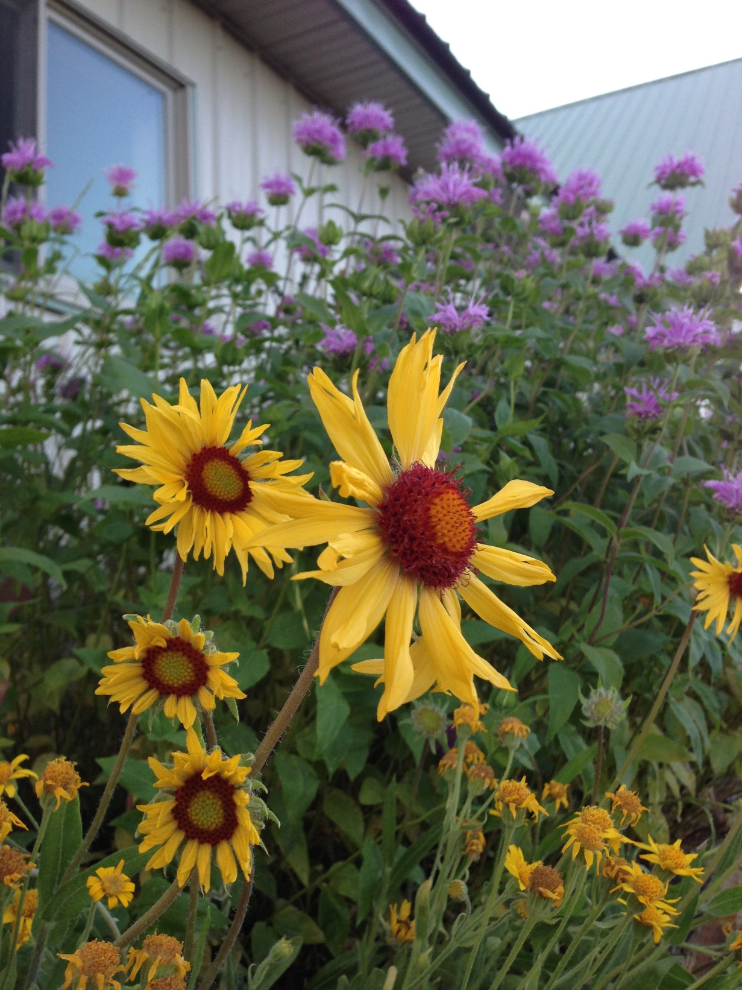
Native Plants
Once established, native plants are easy to maintain because they are adapted to
Montana’s temperatures, rainfall patterns,
and soil conditions.
They resist local pests and disease.
Native plants reduce soil erosion, build soil structure, and absorb rainfall.
Native plants are preferred by native birds and wildlife for food & shelter.

Slide 37
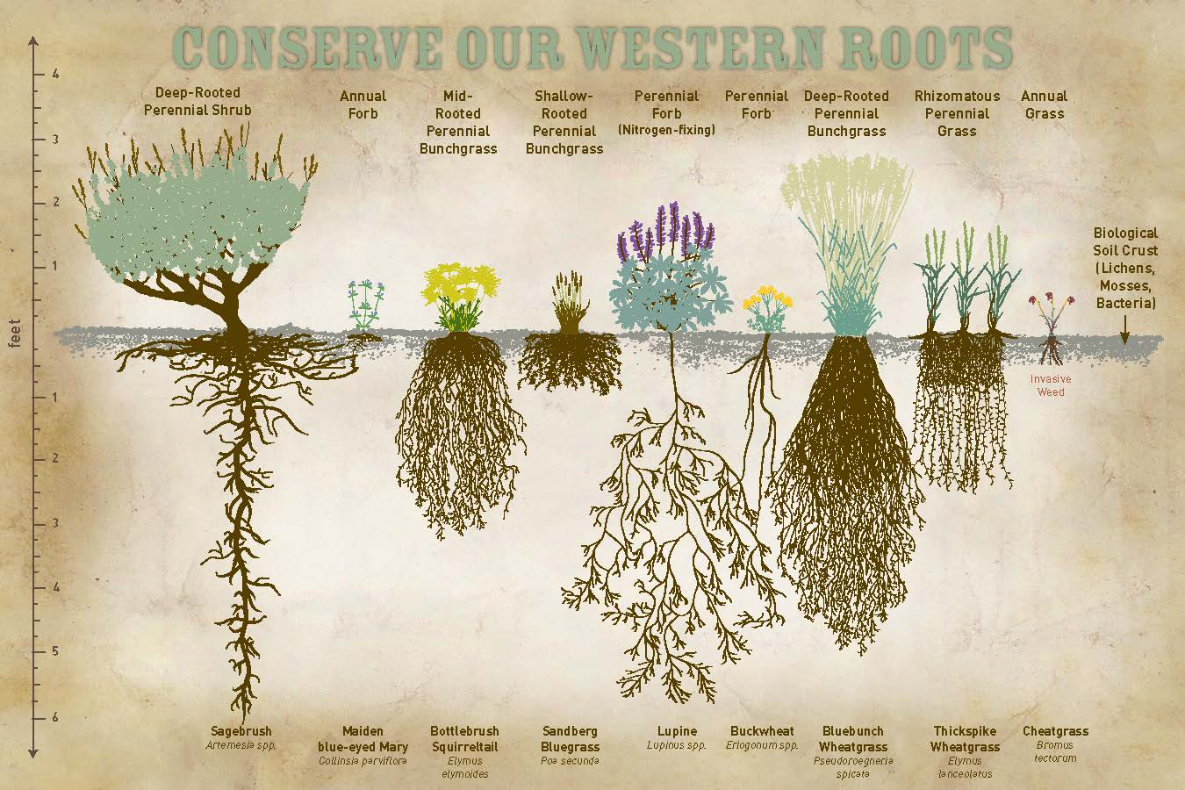

Slide 38
What’s So Great About Native Plants?
Native plants help you use less fertilizers.
Native plants help you use less pesticides.
Native plants help you use less water.
Native plants help you keep the air around you cleaner - 1 gas-powered lawnmower emits 11 times the air pollution of a new car.

Slide 39
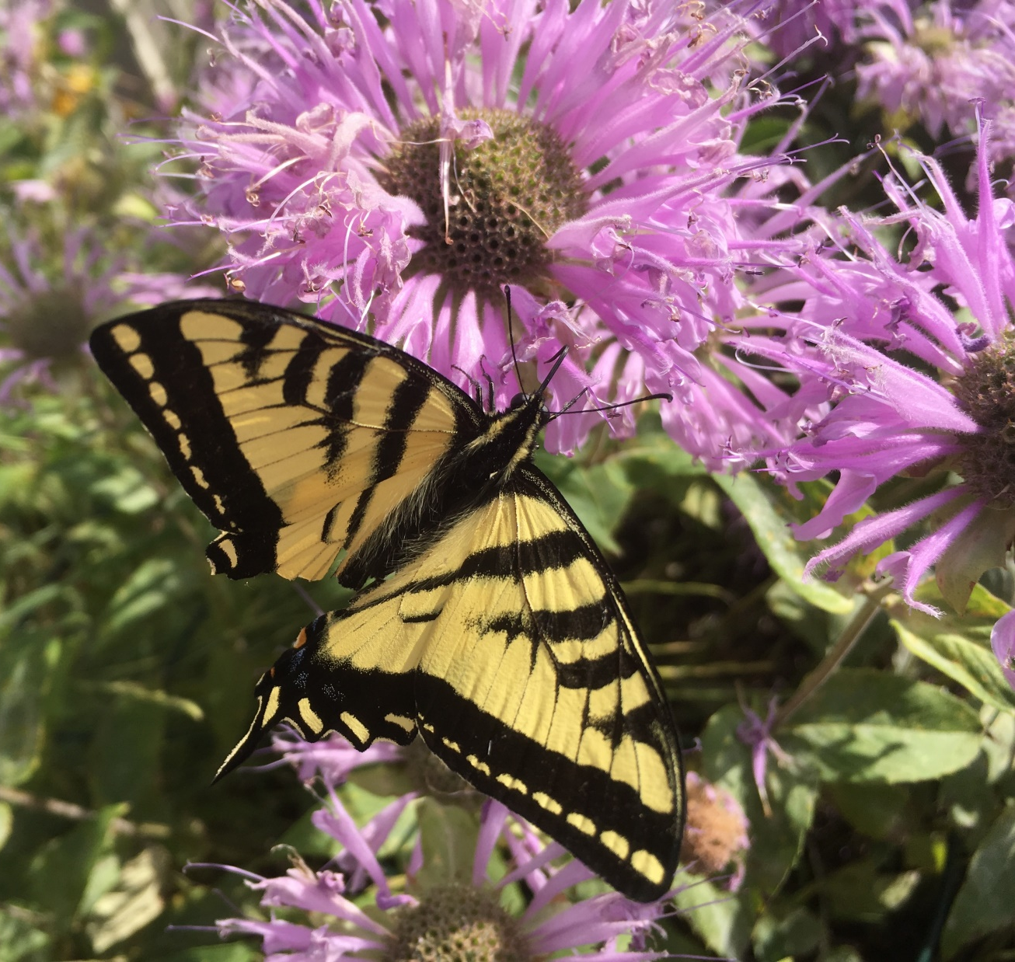
What’s So Great About Native Plants?
Native plants provide shelter and food for wildlife and support pollinators.
Native plants promote biodiversity and stewardship of our natural heritage.
Native plants have been shown to save money in many different ways.

Slide 40
Traditional vs Xeriscape Lawns
Traditional Lawn
An average traditional 10,000 square-foot Kentucky bluegrass lawn:
Requires
3,800 gallons of water per week
54,340 gallons of water per growing season
Costs on average $353.50 per growing season for electricity for pumping
Xeriscape Lawn
A typical 10,000 square-foot xeriscaped area:
Requires
2,318 gallons of water per week
33,142 gallons of water per growing season
Costs on average $202.50 per growing season for electricity for pumping

Slide 41
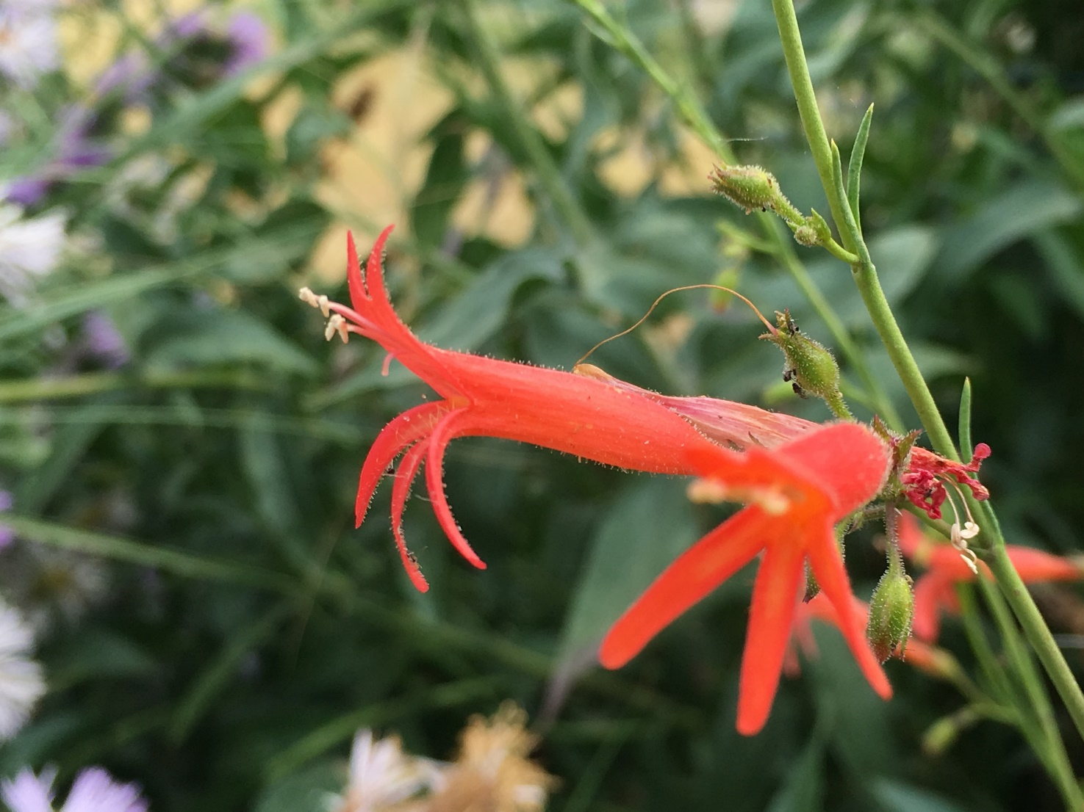
Deep but Infrequent Watering
Encourages grasses and plants to develop deeper roots that are less subject to heat or drought stress because they can take advantage of moisture deeper in the soil, especially when the surface dries out.

Slide 42
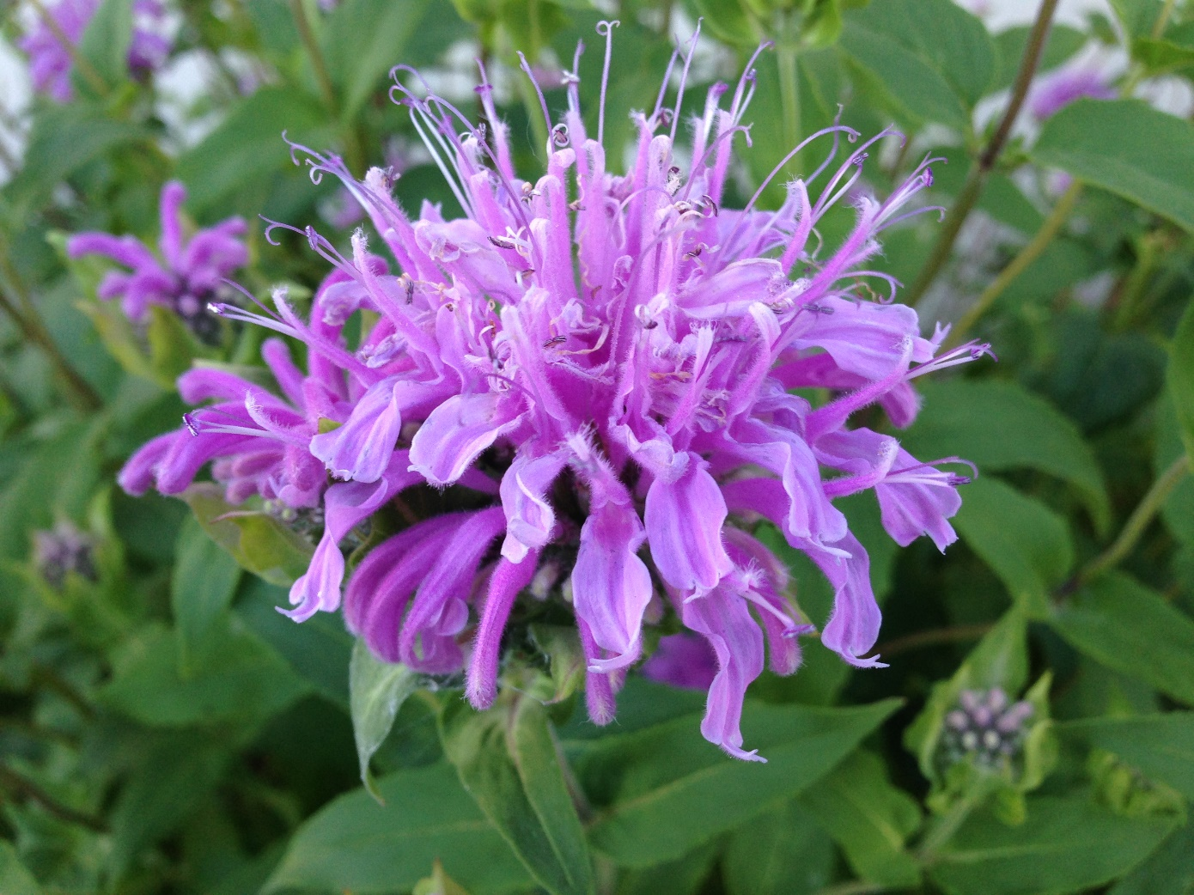
Water between 5-9am!
Early watering allows the plants to maximize their growing processes as the day warms up and the sun rises.
Reduces the possibility of fungal or mold growth from excess water sitting on plant and grass leaves.

Slide 43
Landscaping with Natives
Many resources available online

Slide 44
Help Available
Gallatin Invasive Species Alliance
www.gallatinisa.org
info@gallatinisa.org
406-209-0905
Gallatin County Weed District 582-3265
- Cost share, Sprayer rental, property inspections, enforcement & compliance

