Slide 1
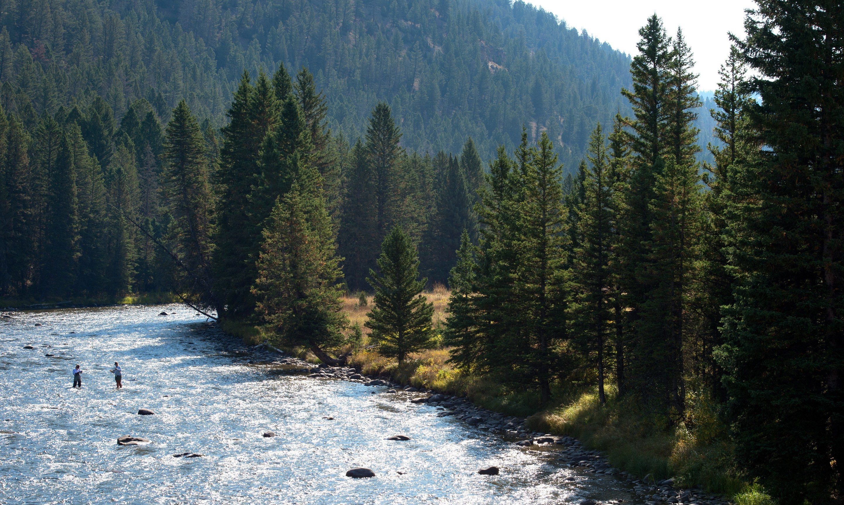
Conserving Land and Protecting Water Quality in Gallatin County

Slide 2
Overview
Goals for this course
Gallatin River Task Force
Course Outline

Slide 3
Goals for this Course
To empower realtors with relevant water resource information so that:
Accurately and professionally represent potential water resource issues
Provide landowners necessary information to make legal, wise, and sustainable decisions on their property that affect water resources
Identify permit requirements for developing properties with on site wastewater treatment systems

Slide 4
Gallatin River Task Force
Mission: Partner with our community to inspire stewardship of the Gallatin River Watershed
Vision: A healthy Gallatin Watershed for future generations
Three programs
Watershed Monitoring
Conservation
Education & Outreach

Slide 5
Course Outline
Overview of Water Resources
Septic permitting
Introduction to Groundwater Information Center
Water Rights Introduction
Noxious Weed Ecology
Conservation Tools for Private Land

Slide 6
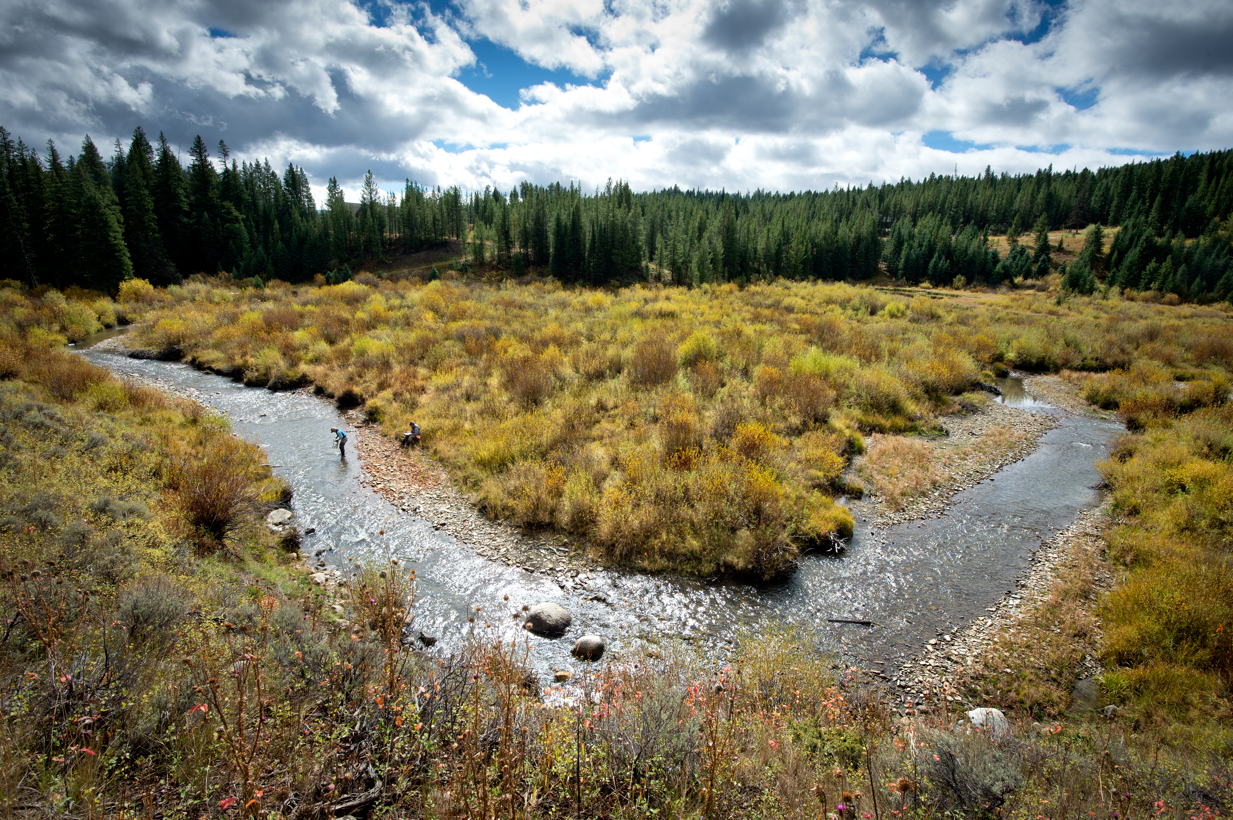
Thank you!
Notes:
Drought in the Classroom

