Slide 1
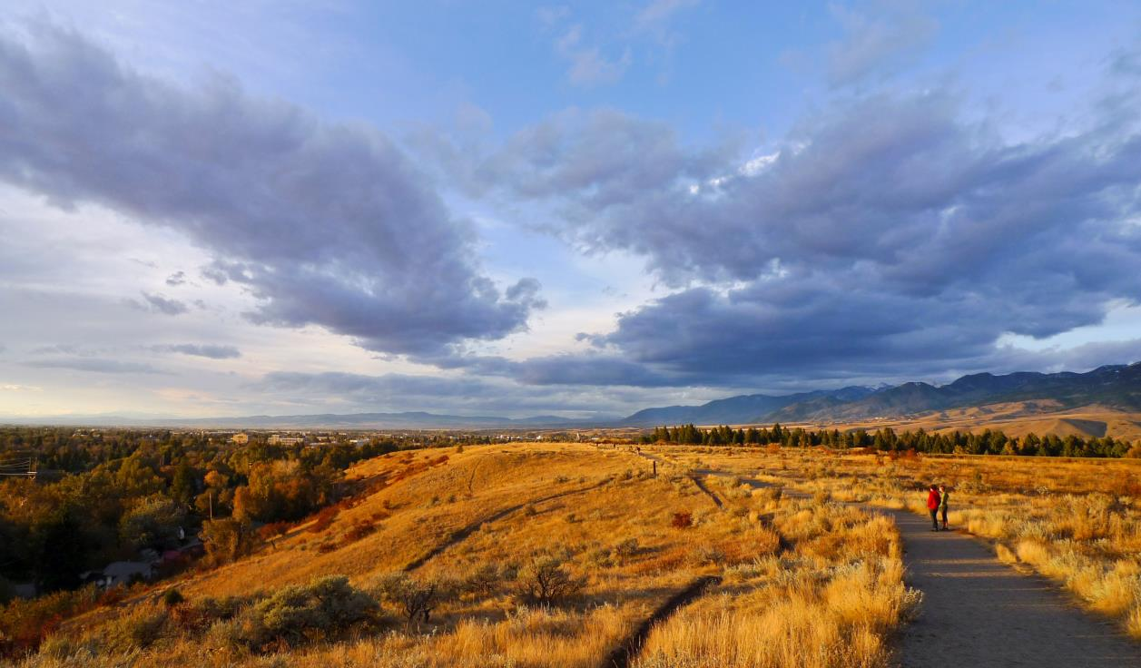

Slide 2
Overview
About GVLT
What a conservation easement is & isn’t
Why landowners conserve their land
How the community benefits
Conservation easement stewardship and partnership
Local success stories
Notes:
Outline the contents of the talk…

Slide 3
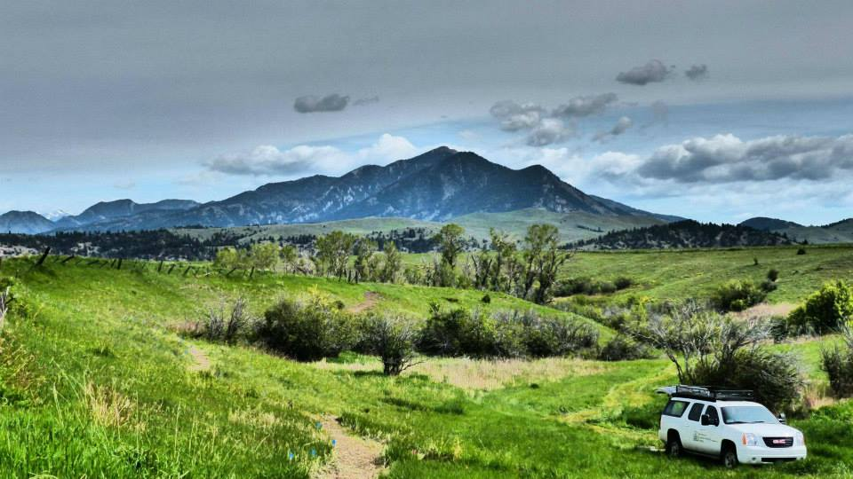
Gallatin Valley Land Trust
Since 1990 - 501(c)(3) non-profit
100 easements, 45,000 acres conserved
80+ miles of trail
Professional staff of 9
2,000+ members

Slide 4
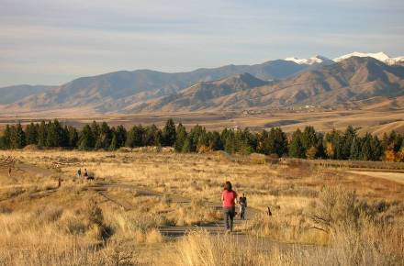
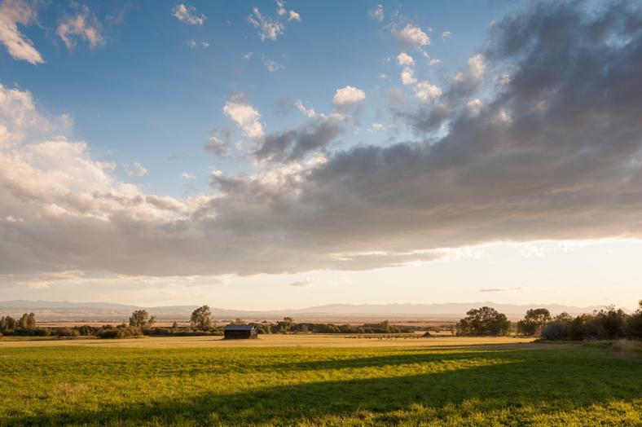
Mission
Gallatin Valley Land Trust connects people, communities, and open lands through conservation of working farms and ranches, healthy rivers, and wildlife habitat…
… and the creation of trails in the Montana headwaters of the Missouri and Upper Yellowstone Rivers.
Notes:
GVLT = non profit with two-fold mission…

Slide 5
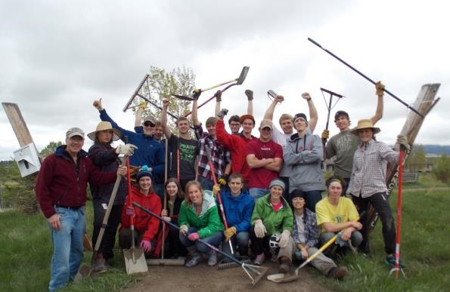
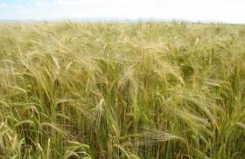
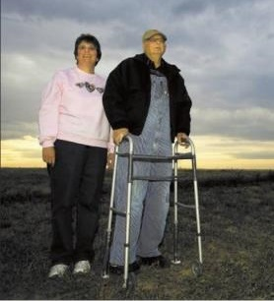
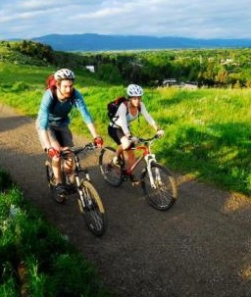
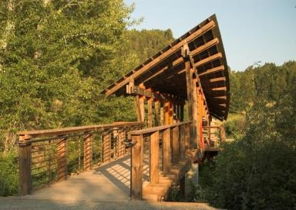
Notes:
(KP)
Since our founding – 42,000 acres, 70+ miles
Creates a legacy for the Gallatin Valley

Slide 6
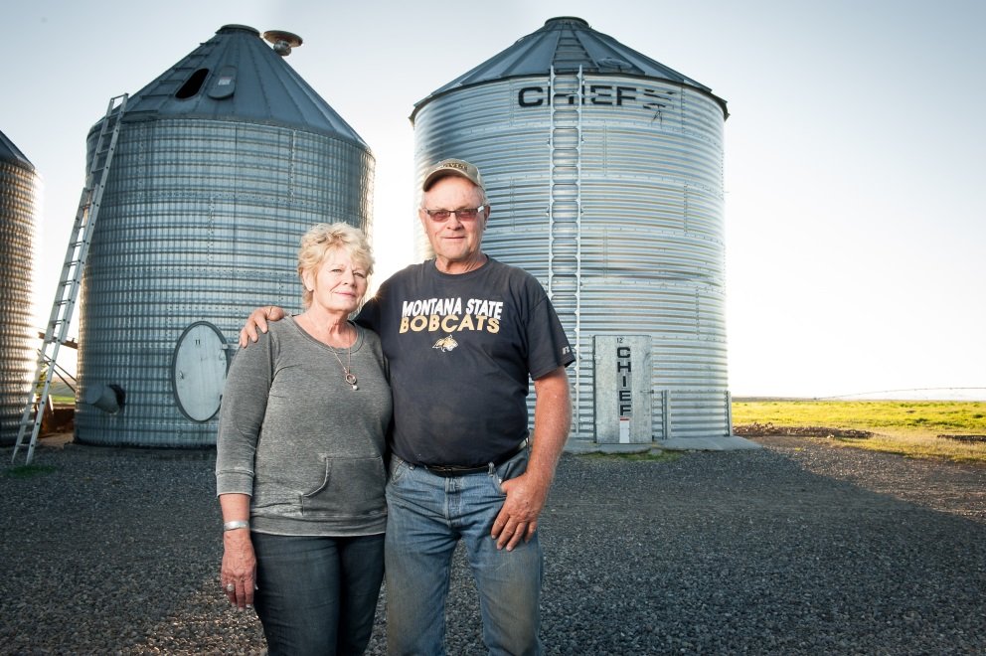
Private Land Conservation
Why?
Keep local agriculture & food viable
Keep working lands in the family
Protect important waterways
Preserve wildlife habitat
Cluster residential development – reduce the costs of sprawl

Slide 7
Open Space Under the Big Sky

Slide 8
What a conservation easement IS
Voluntary
Perpetual
Runs with the land
Customized
Limit development and subdivision
Retain title and management control

Slide 9
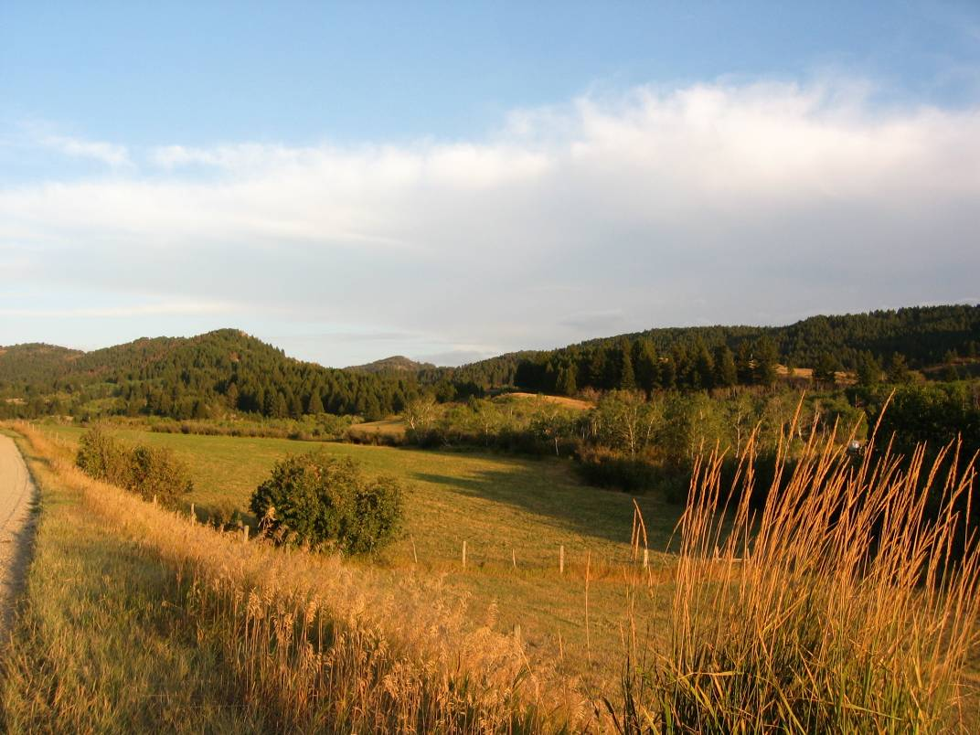
What a conservation easement ISN’T
It isn’t eminent domain
It isn’t a wilderness
It isn’t mandated public access
It isn’t prevented public access
It isn’t a property tax cut
It isn’t a loss of a property right
It isn’t for every landowner and it’s not for all lands

Slide 10
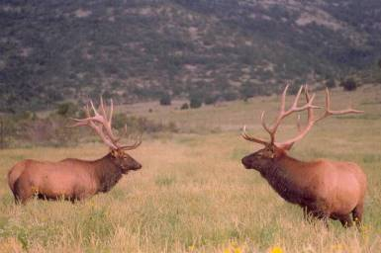
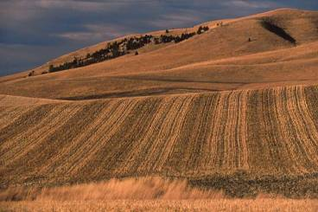
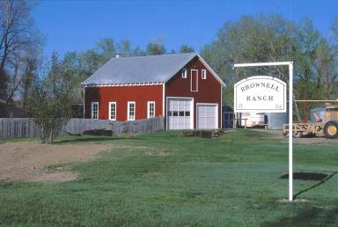
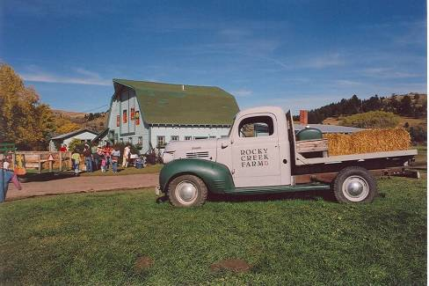
Public Benefit:
Habitat
Open Space, Scenic
Enabling Statutes:
MCA 76-6-101
USC 26 Section 170(h)
Historic Land or Structure
Public Access
Notes:
10
Conservation Purpose = Public Value: ONE OR MORE
Enabling Statutes:
MCA 76-6-101
USC 26 Section 170(h)

Slide 11
Easement Terms
All customized, unique
Limit number/sizes of any future divisions
Limit residential development
No limit to agricultural operations
Timber harvest with management plan in place
Landowner retains:
Day-to-day management of property
Determining who has access to property
Notes:
Outline the contents of the talk…

Slide 12
Easement Process
Initial Discussions
Cost Agreement
Easement Terms
Project Closing
Discuss goals for property
Determine if CE is right tool
Site visit
Consult with advisors
Outline project costs
Identify possible funding sources
Determine CE value
Discuss easement terms
Draft & review easement
Other due diligence
Easement approval
Annual monitoring process
Stewardship services
Notes:
Outline the contents of the talk…

Slide 13
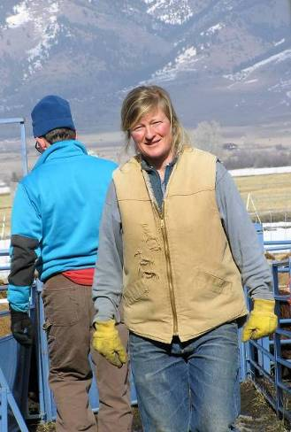
Why do landowners conserve their land?
Family vision & tradition
Protect the land and its resources
Perpetuate good stewardship
Keep the land in the family
Legacy planning

Slide 14
Financial Benefits to Landowners
Income tax deduction for the value of the easement
Estate tax benefit, making it easier to pass land to heirs
Cash payment, in some cases

Slide 15
Conservation Easement Valuation
To qualify for tax deduction:
Full appraisal
By qualified appraiser following USPAP, IRS requirements
Easement meets conditions of IRC 170(h)
To qualify for cash compensation:
Limited funding available for
Agriculture
Wetlands
Public access

Slide 16
Conservation Easement Value
Conservation
Easement Value
“Before Easement”
Unencumbered
Fair Market Value
“After Easement”
Encumbered
Fair Market Value

Slide 17
Conservation Easement Value
Conservation
Easement Value
“After Easement”
Encumbered
Fair Market Value
Theoretical, appraised value
Market conditions determine actual resale value

Slide 18
Conservation Easement Value
Considered a Charitable Gift
if certain conditions are met
Conservation
Easement Value
Claim as deduction at up to 50% AGI for up to 16 years
(100% for farmers & ranchers)
If some portion compensated, remainder is deductible
“After Easement”
Encumbered
Fair Market Value

Slide 19
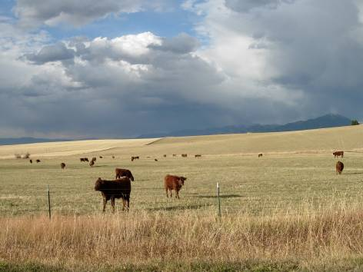
How does the community benefit?
Cost of public services reduced by containing sprawl
Local agriculture remains viable
Water quality protected
Wildlife habitat and other natural resources conserved
Scenic views protected

Slide 20
Stewardship of Conserved Land
Monitor conservation values in perpetuity
Connect landowners to resource and policy information
Consultation on management issues
Cost share funding

Slide 21
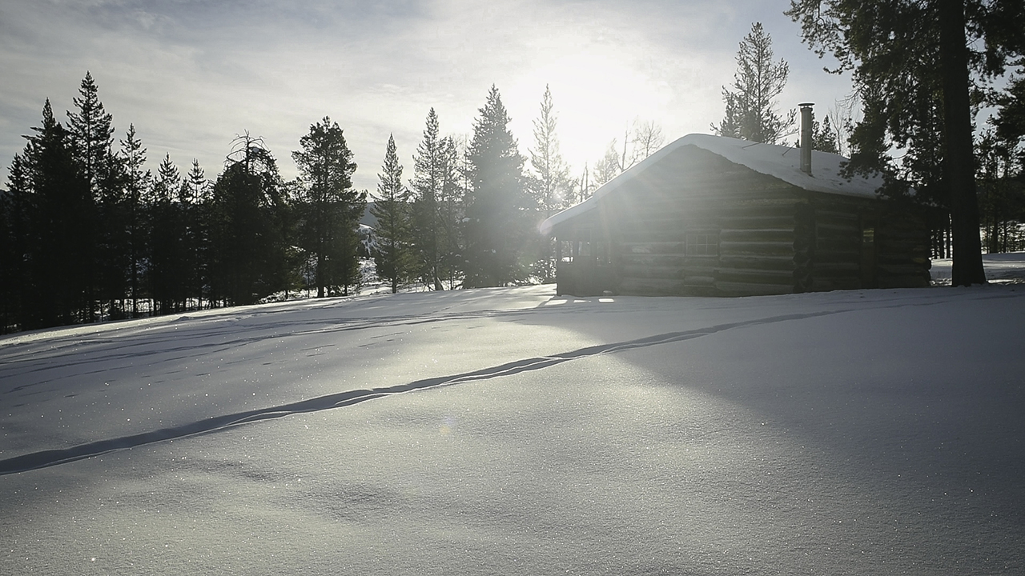
Examples from Big Sky: Pessl Family Ranch

Slide 22
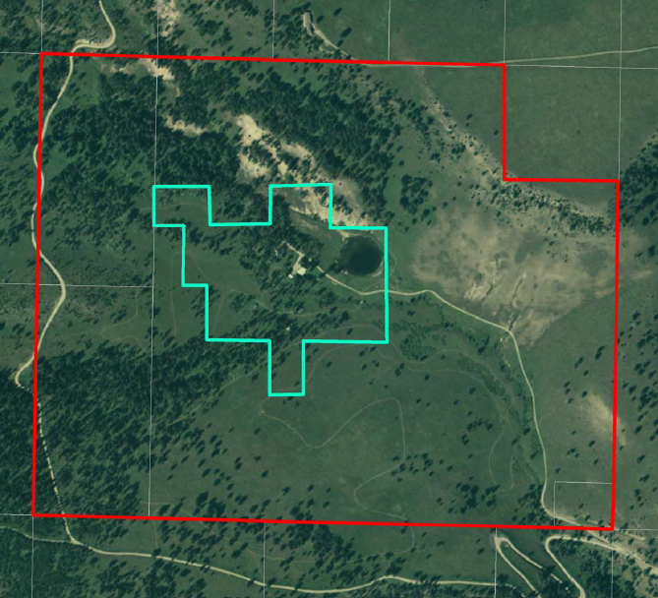
170 acre open-space area for wildlife, scenic views
20-acre building area
Trails, timber mgmt allowed
Residential
Building Area

Slide 23
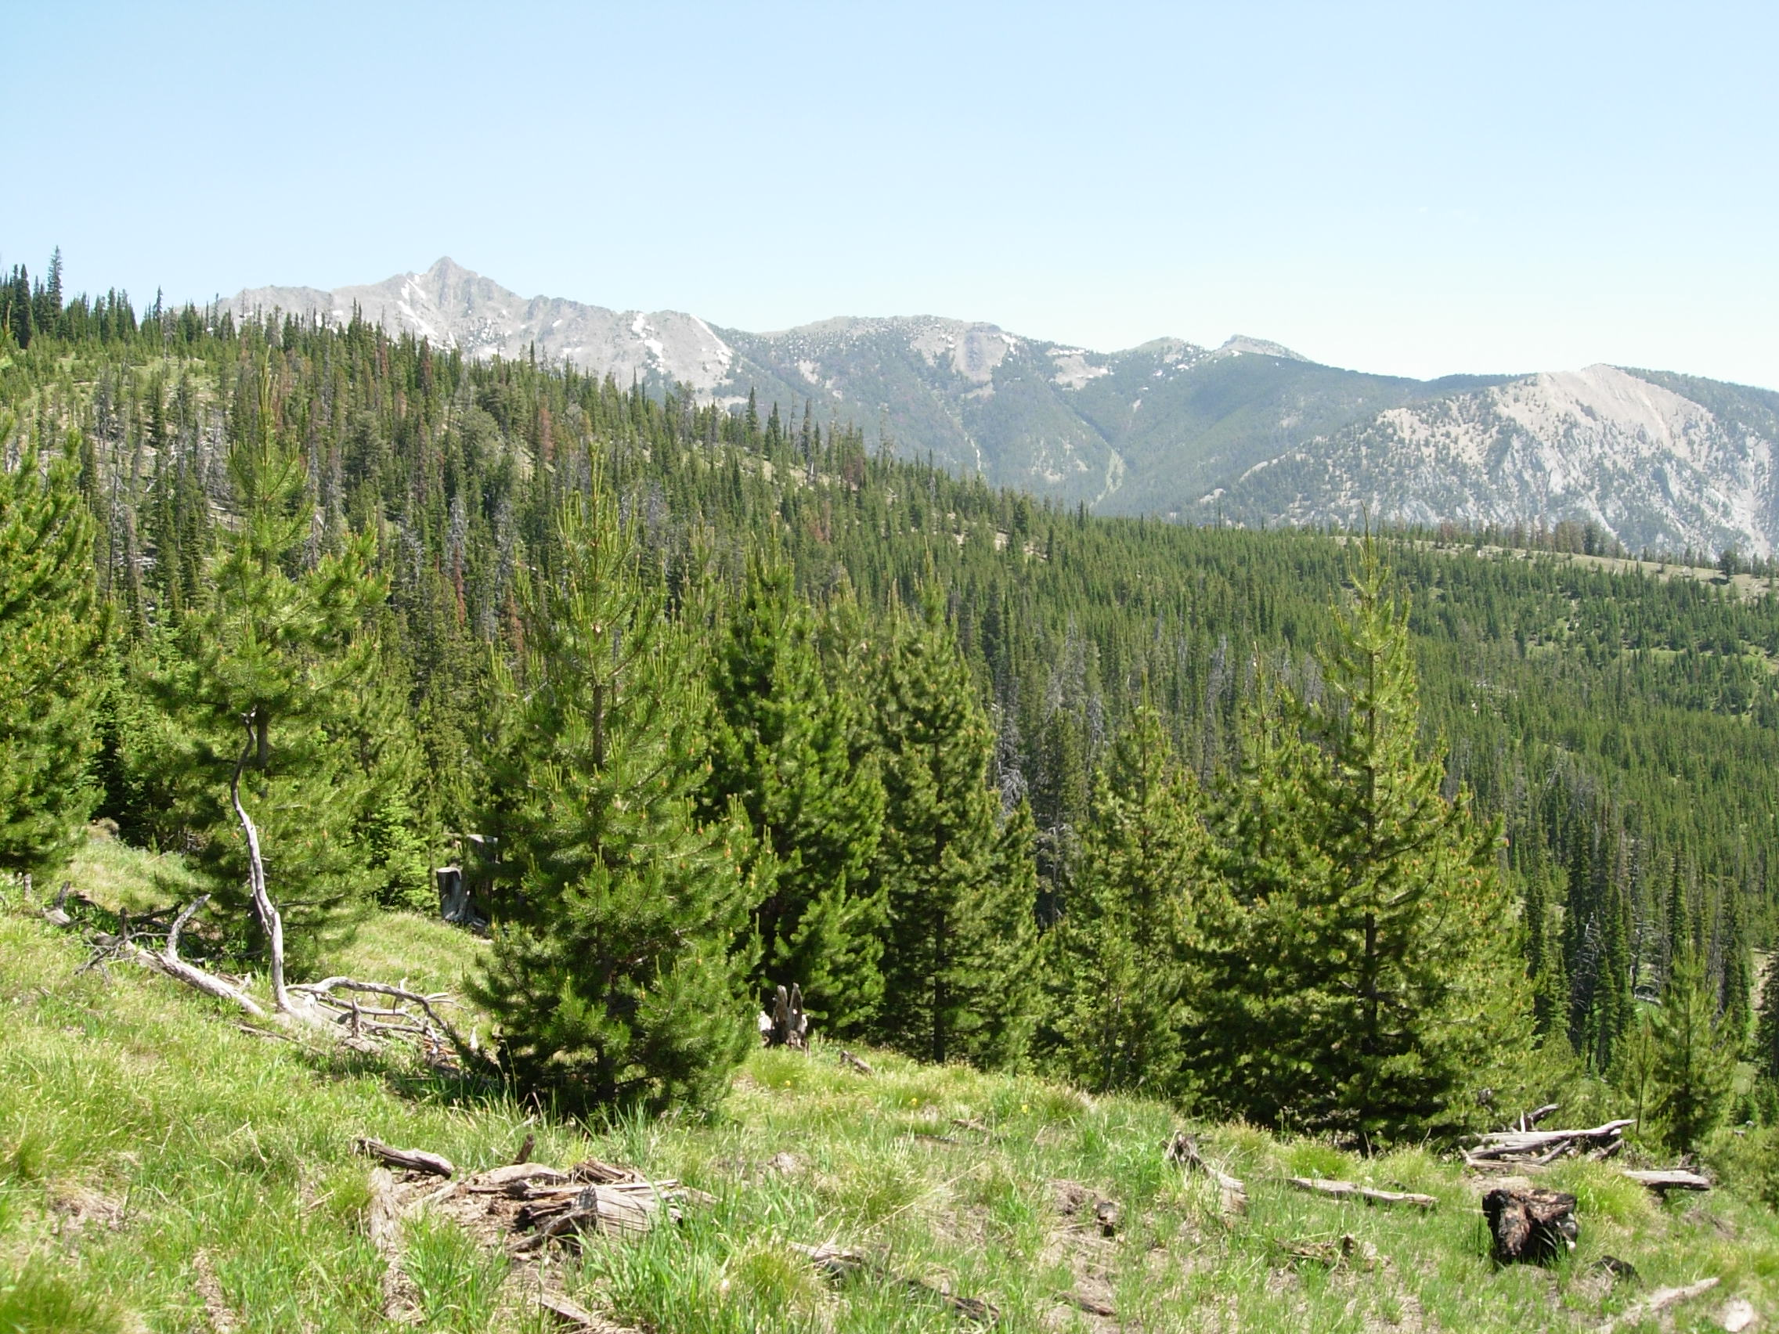
Examples from Big Sky: Summit View

Slide 24
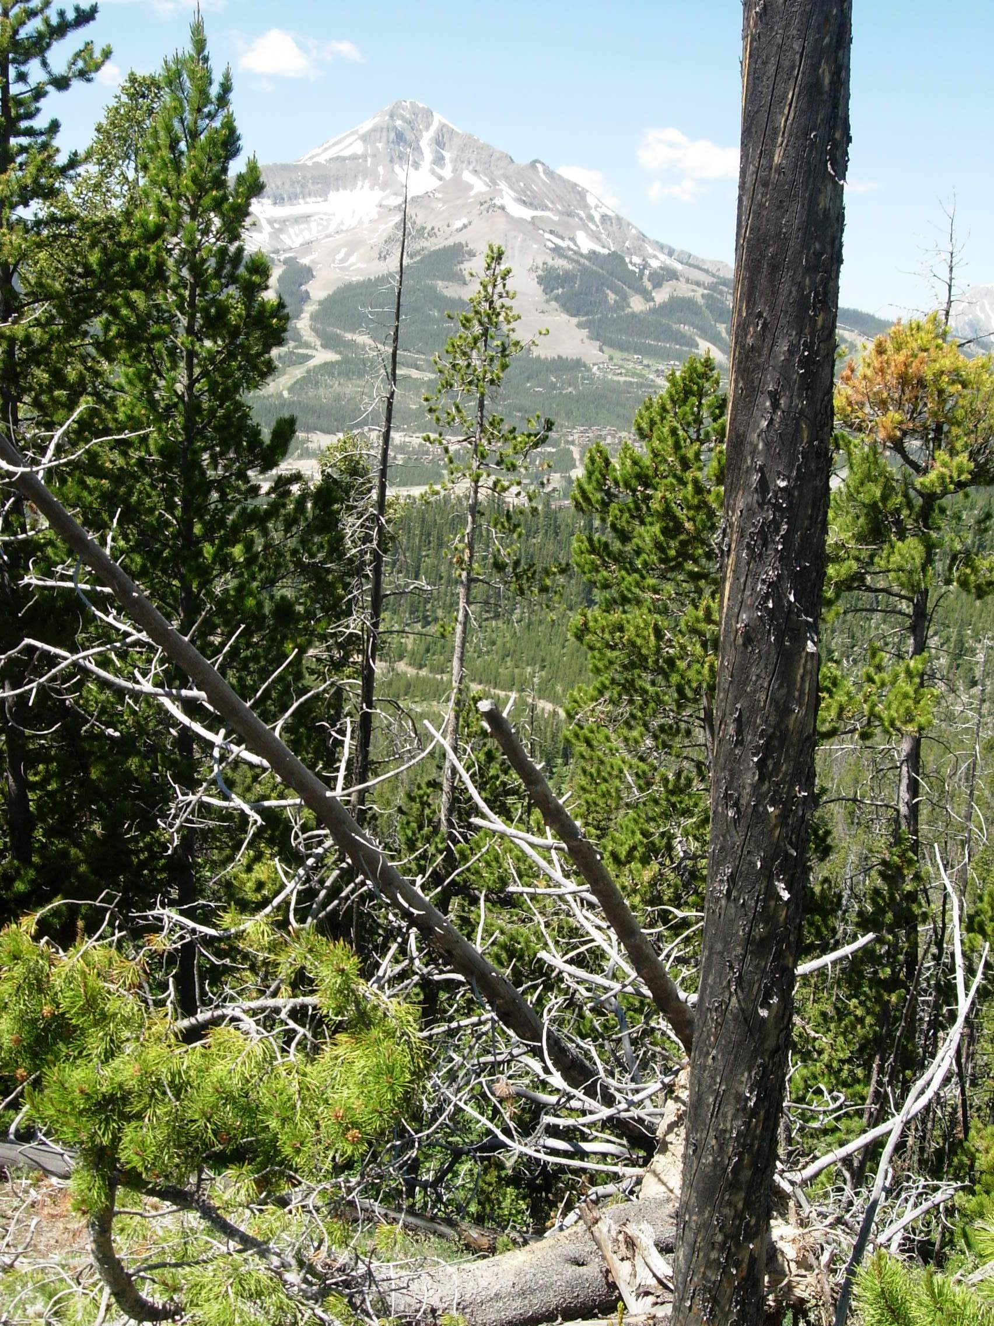
368-acres
No divisions
No structures except for recreation
Habitat restoration allowed
Trails allowed

Slide 25
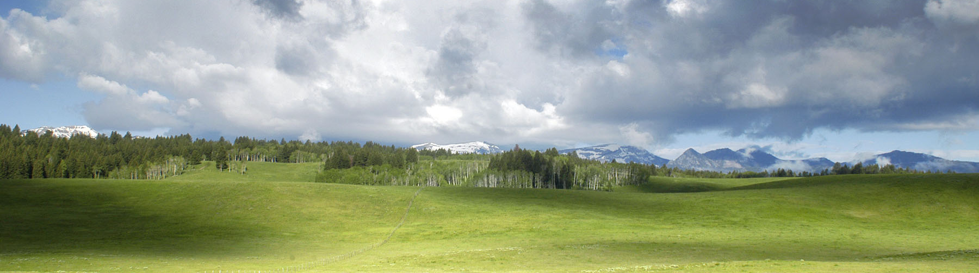
Take Home Messages
Easements customized
Public benefits: wildlife, open space
Personal benefits: tax deductions, peace of mind
GVLT can help design a plan that works for your land and for you

Slide 26
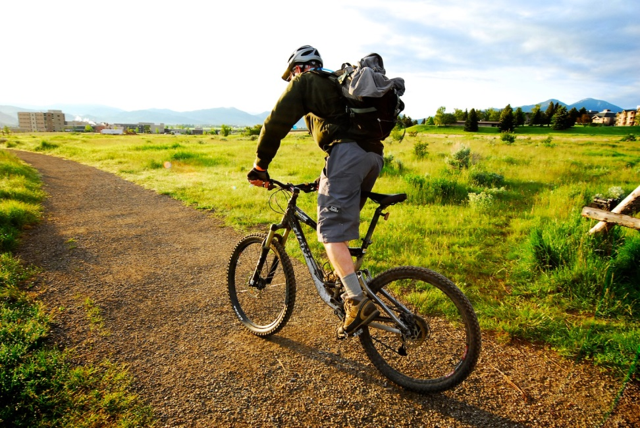
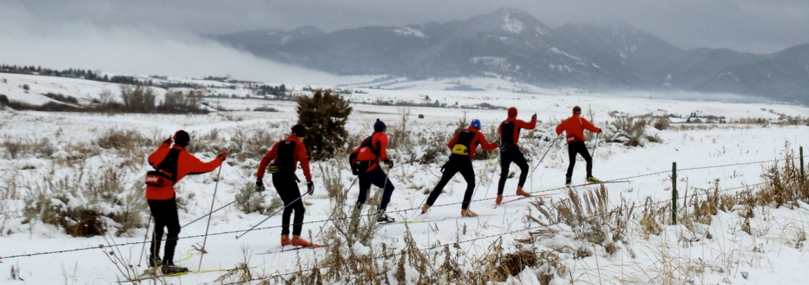
Thank You!
www.gvlt.org
Notes:
KP

Slide 27
The Pessl Family Story

Slide 28
Mechanisms for Conservation
Deed Restrictions
Conservation Easement
Fee Land
Less liability
& responsibility
More liability
& responsibility

