Slide 1
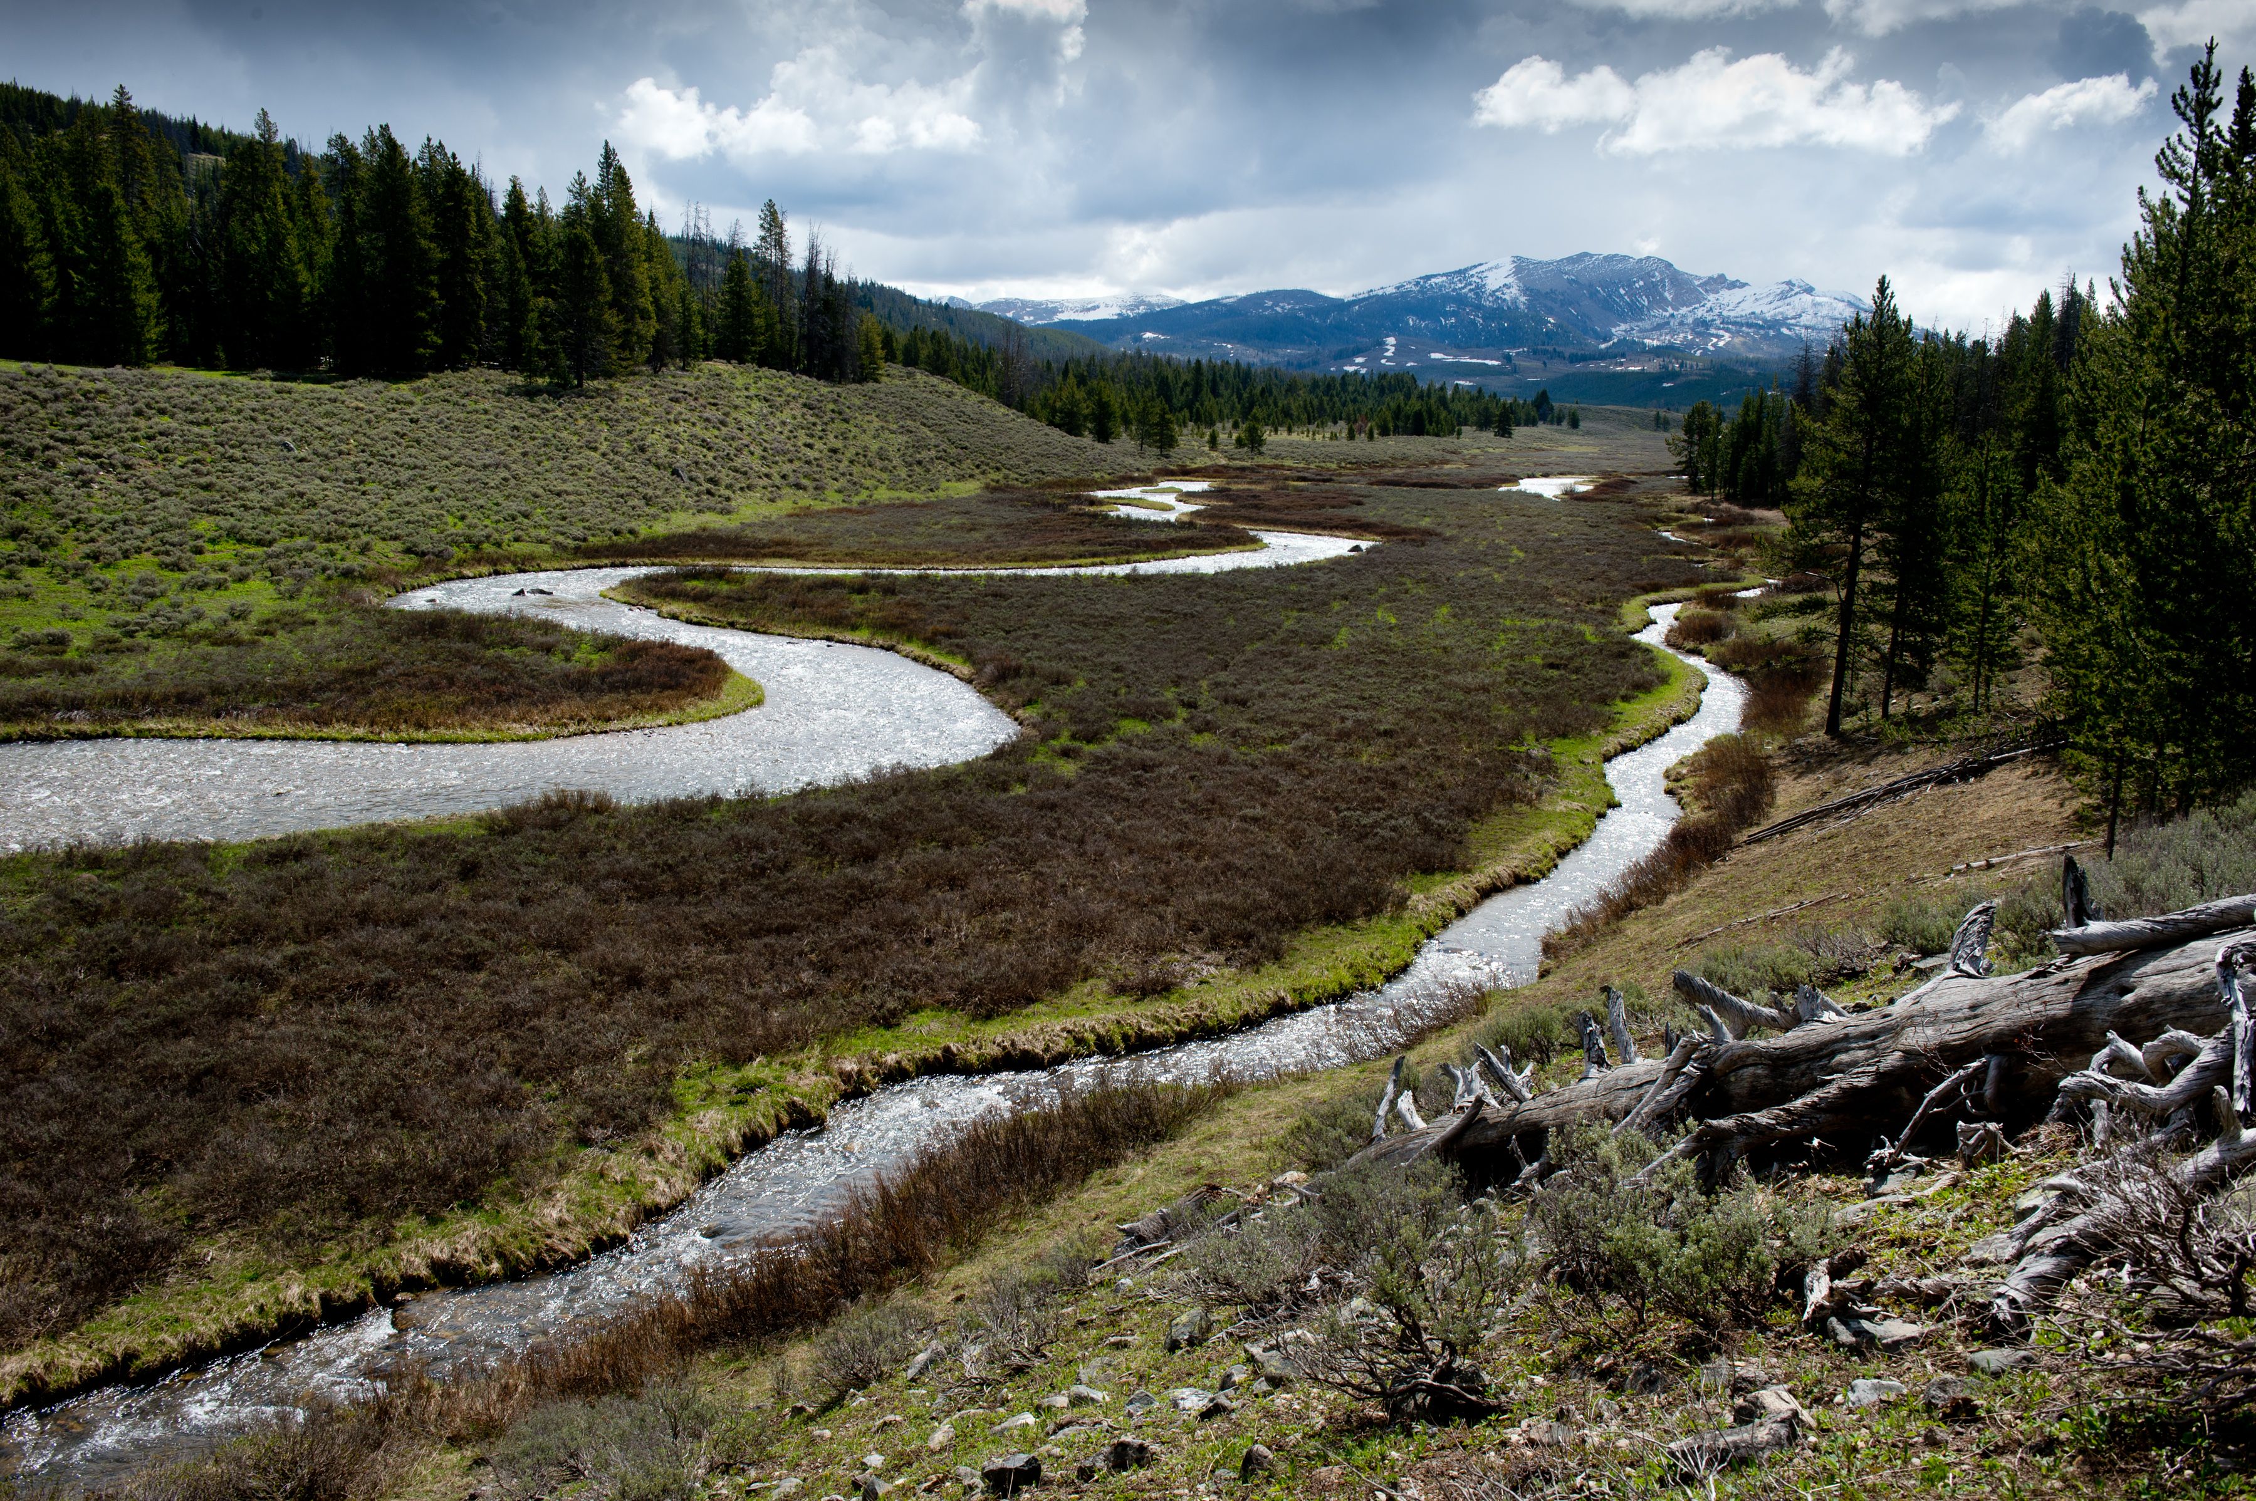
How to Connect New Property Owners to Well & Septic Resources

Slide 2
Well & Septic Systems are Part of the Water Cycle

Slide 3
A Conventional Well & Septic System

Slide 4
Clean Rivers Begin in Your Home

Slide 5
With an onsite water supply and wastewater treatment system, who can protect a homeowner’s drinking water supply and prevent wastewater leaks?

Slide 6
Who can protect water quality?

Slide 7
Water System Considerations for Buying or Building a New Home

Slide 8
Tips from MSU Extension for Protecting Your Well
Install a sanitary well cap
Ensure well casing extends 12 to 18 inches above the ground
Ensure ground slopes away from well head
Keep herbicides, animal manure, oil, grease, and household chemicals at least 100 feet from the well head
Test your well annually for nitrates and bacteria and keep maintenance records

Slide 9
Tips for Protecting Your Septic System
Dispose of waste properly: Flushable does not mean septic safe
Pump as indicated by inspections, generally every 3-5 years, and clean effluent filter every 6 months. Keep maintenance records.
Conserve water: fix leaks, install efficient appliances, and don’t leave the water running.
Don’t park on your drain field or plant deep rooted trees near your septic tank.
Grab a Septic Smart brochure for more information…

Slide 10
A Message from the Lone Peak High School Environmental Science Class

Slide 11
Local Well and Septic Resources
Information & Instruction:
Gallatin River Task Force Septic Smart Brochure and Website: http://www.gallatinrivertaskforce.org/septicsmart/
Gallatin County Local Water Quality District: https://glwqd.org/
MSU Extension YouTube Channel: https://www.youtube.com/user/MSUExtWaterQuality/videos
Well Test Kits:
Gallatin River Task Force Office: #406-993-2519
Gallatin County Local Water Quality District Office: #406-582-3148
Folders for Well & Septic Records:
Gallatin River Task Force: #406-993-2519
MSU Extension: #406-994-7381
Septic Permits, Maintenance Records, List of Certified Septic Pumpers and Inspectors, and List of Certified Well Drillers:
Gallatin County Health Department: #406-582-3100

Slide 12
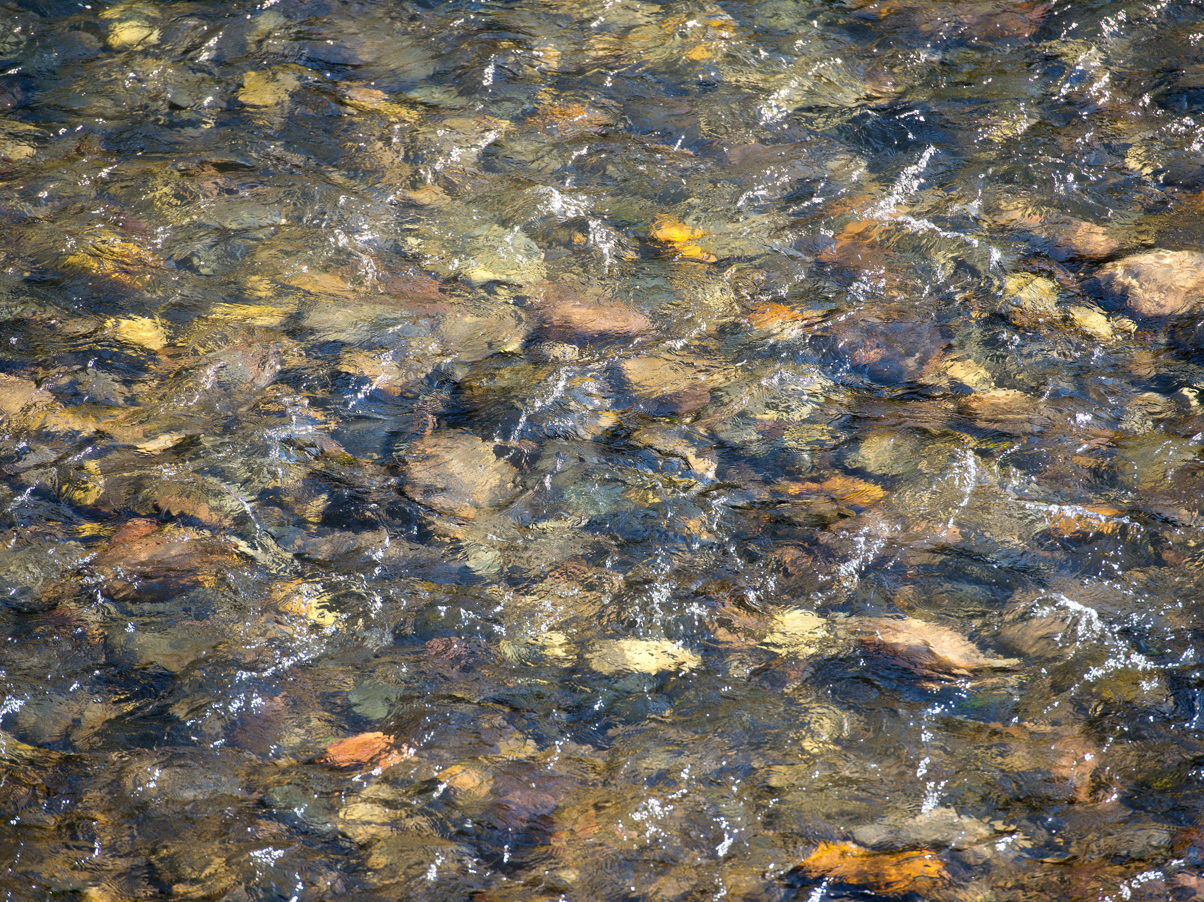
Thank You

Slide 13
Graphic Credits
Photos by Rich Addicks
http://water.usgs.gov/edu/graphics/watercyclesummary.jpg
http://whidbey-eco.net/wp-content/uploads/2014/03/septic.png
http://paulmirocha.com/wp/wp-content/uploads/2015/04/non-point-source-pollution_mirocha.jpg
http://www.mastgeneralstore.com/ProductImages//230098aa-bb1a-4cf9-b049-279106d01818/images/ProdDetail_Retina_10997.jpg
https://www.youtube.com/user/MSUExtWaterQuality/videos
Lone Peak High School Environmental Science Class

